Slide 1
STARTUP SUCCESS PREDICTION

Slide 2
HELLO!!
We are
Team Startup Success Prediction
Tawsif Mahmud
1912411042
Jiaul Haque Saboj
1912065042
Sadia Sifati Shammee
1912304042
Let us Predict your Startup Success!!!

Slide 3
All about the project
Startups play a major role in economic growth. They bring new ideas, spur innovation, create employment thereby moving the economy. There has been an exponential growth in startups over the past few years. Predicting the success of a startup allows investors to find companies that have the potential for rapid growth, thereby allowing them to be one step ahead of the competition.
Objective
The objective is to predict whether a startup which is currently operating turns into a success or a failure. The success of a company is defined as the event that gives the company's founders a large sum of money through the process of M&A (Merger and Acquisition) or an IPO (Initial Public Offering). A company would be considered as failed if it had to be shut down.
Platform
The project is ready to use for both Web and Android. Any User Can simply use any platform just with an account creation.

Slide 4
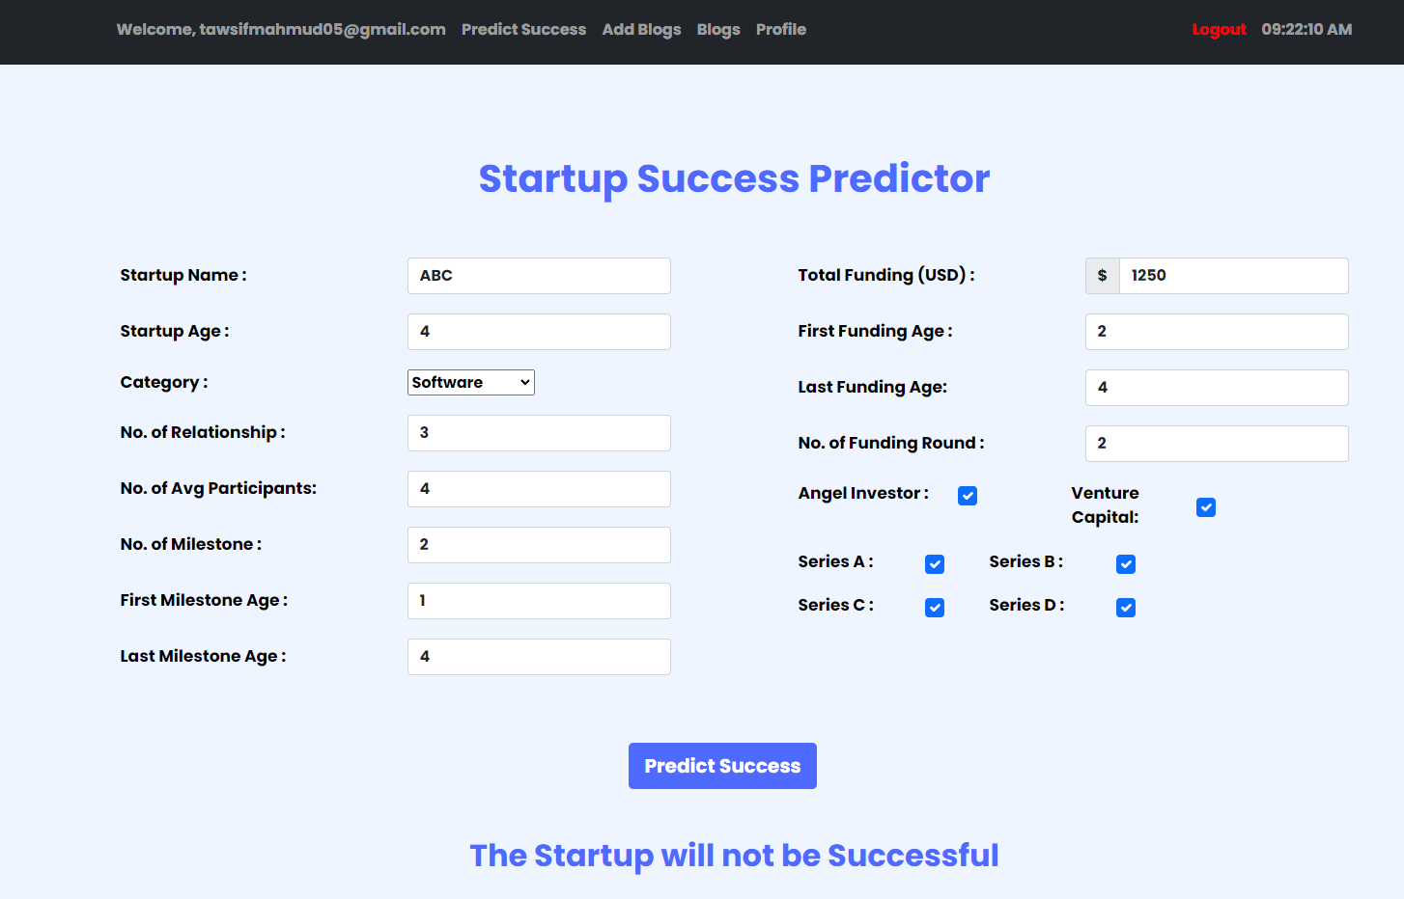
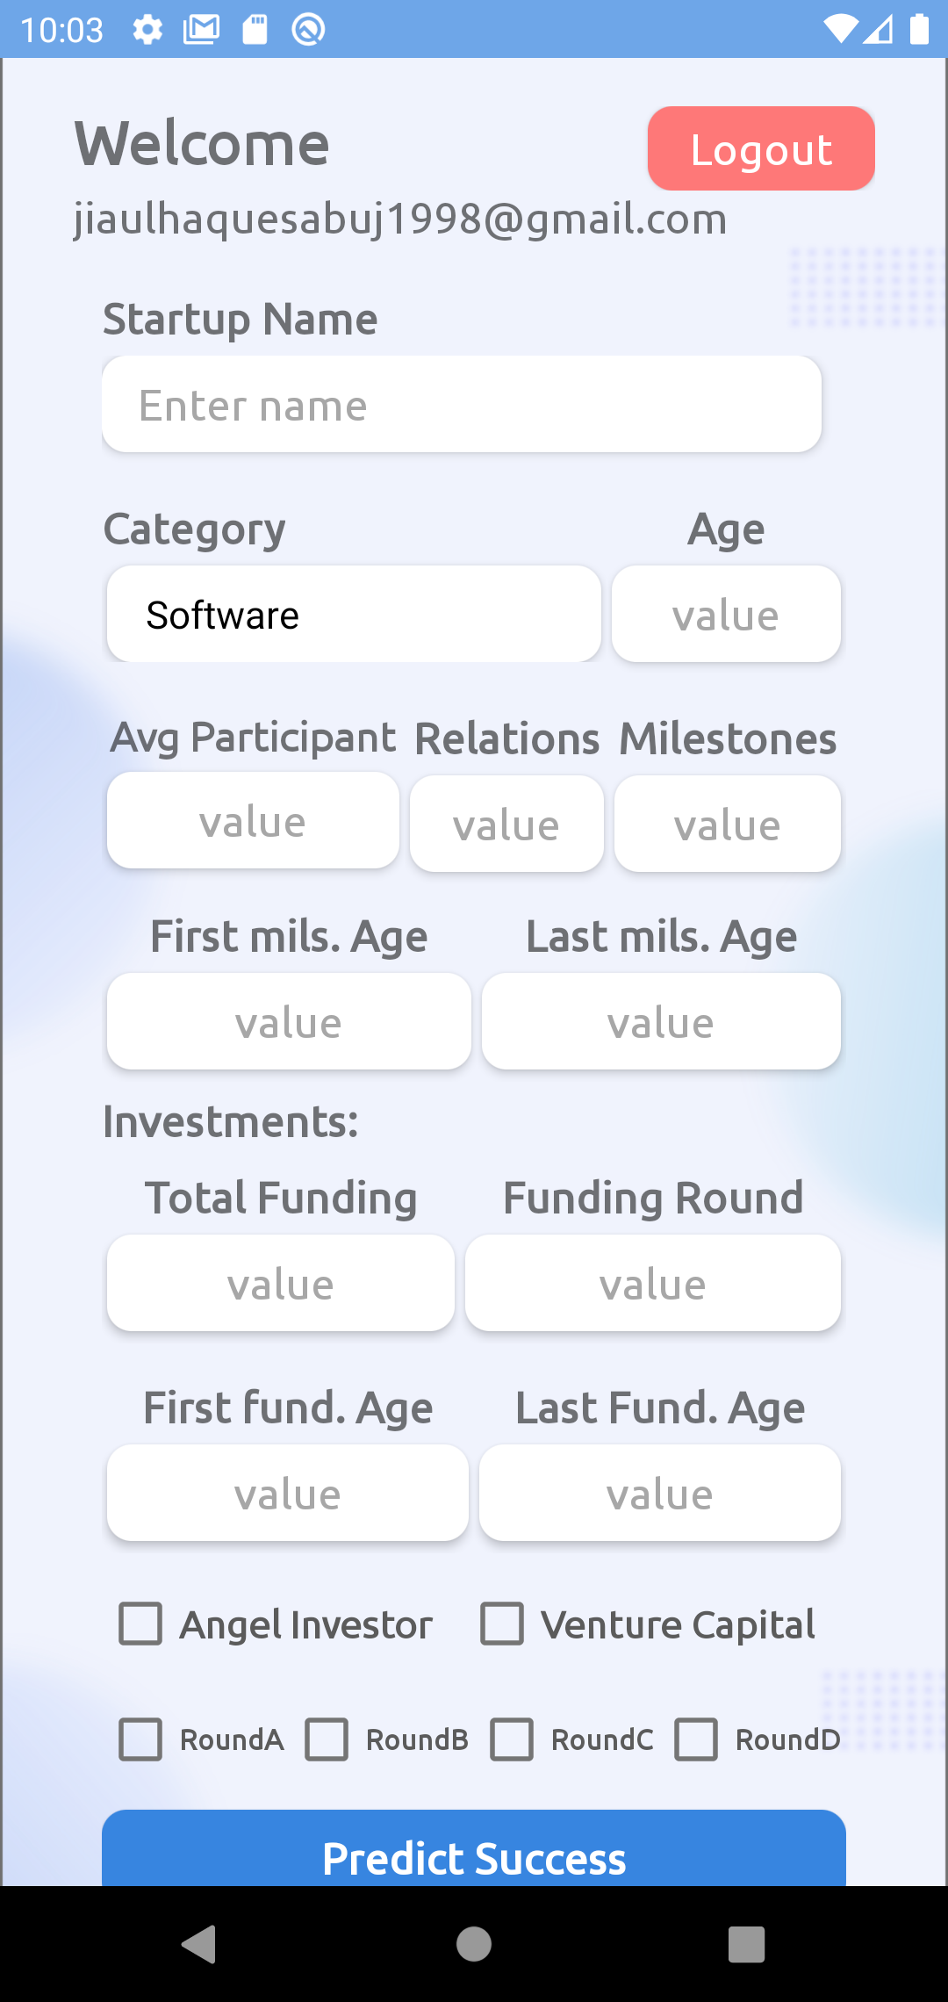
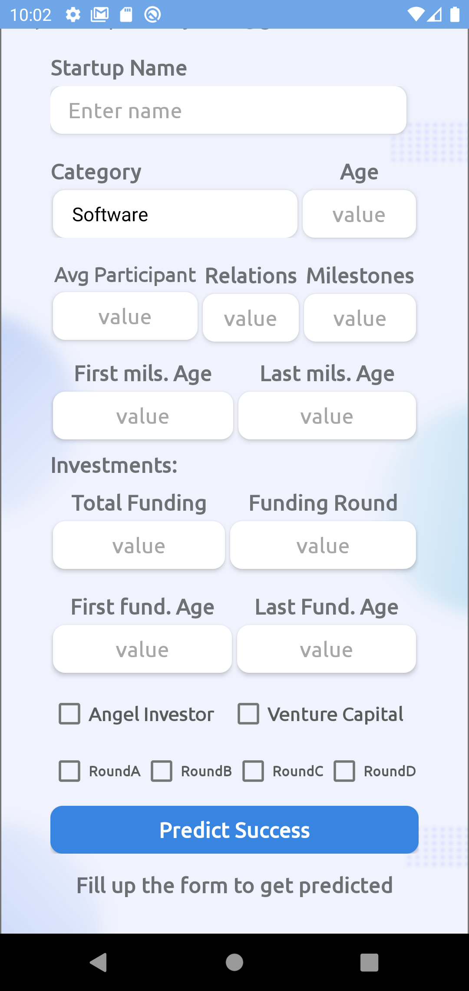
All about the project
Website
Login/Signup: User can signup and login to the web platform with his google account.
Success Predictor: With some required data in the form, user can predict the success of any startup.
Blogging: Posting any kind of blog related to startup is allowed for any user. Other users can read or comment on any blog.
Android
Login/Signup: User can signup and login to the web platform with his google account.
Success Predictor: With some required data in the form, user can predict the success of any startup.

Slide 5



High Level Software Architecture
Web Server
ML Model
Database

Slide 6
ROADMAP
Data Collection
Train Model
Web Implementation
1
3
5
2
4
6
Data Processing
Test Model
Android Implementation

Slide 7
Software Stack
Adobe XD
Visual Studio Code
Android Studio
Postman
Google Colab

Slide 8
Results
ML Model | Training Accuracy | Testing Accuracy
AdaBoost Classifier | 0.82 | 0.79
XGBoost Classifier | 0.89 | 0.83
K-Nearest Neighbor | 0.74 | 0.68

Slide 9
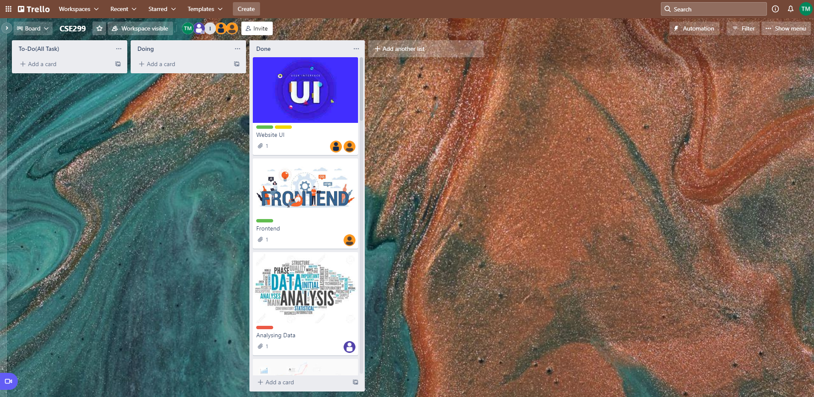
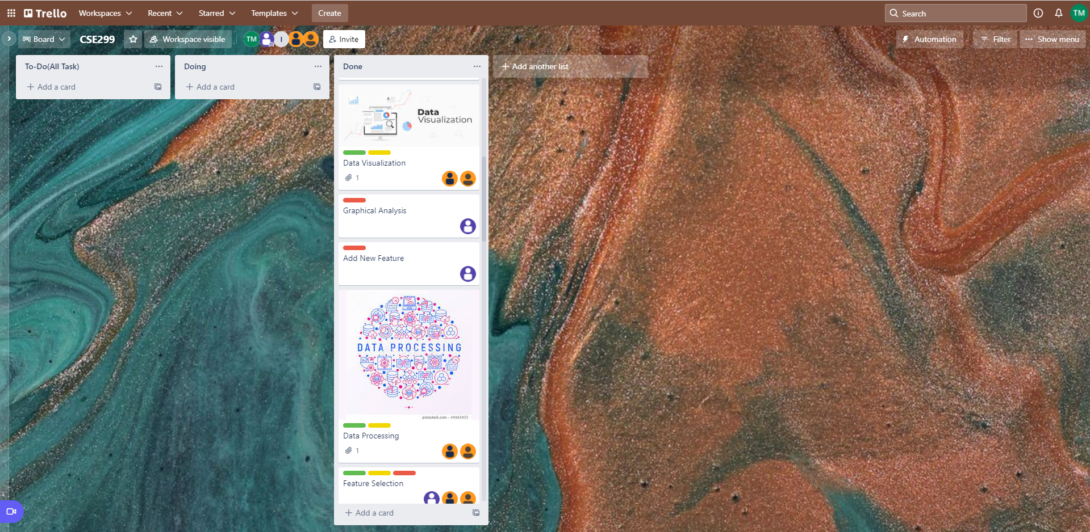
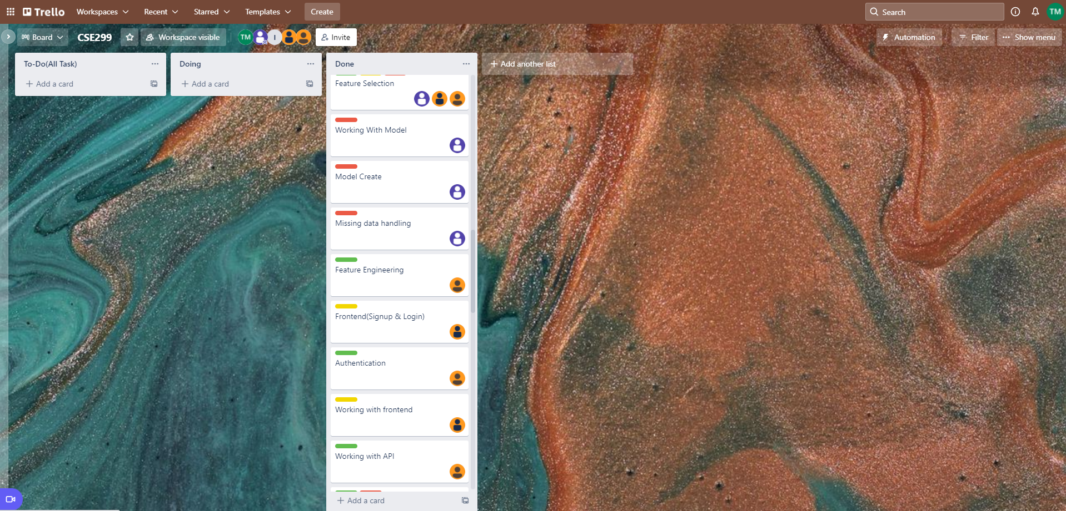
TrelloBoard ScreenShot

Slide 10

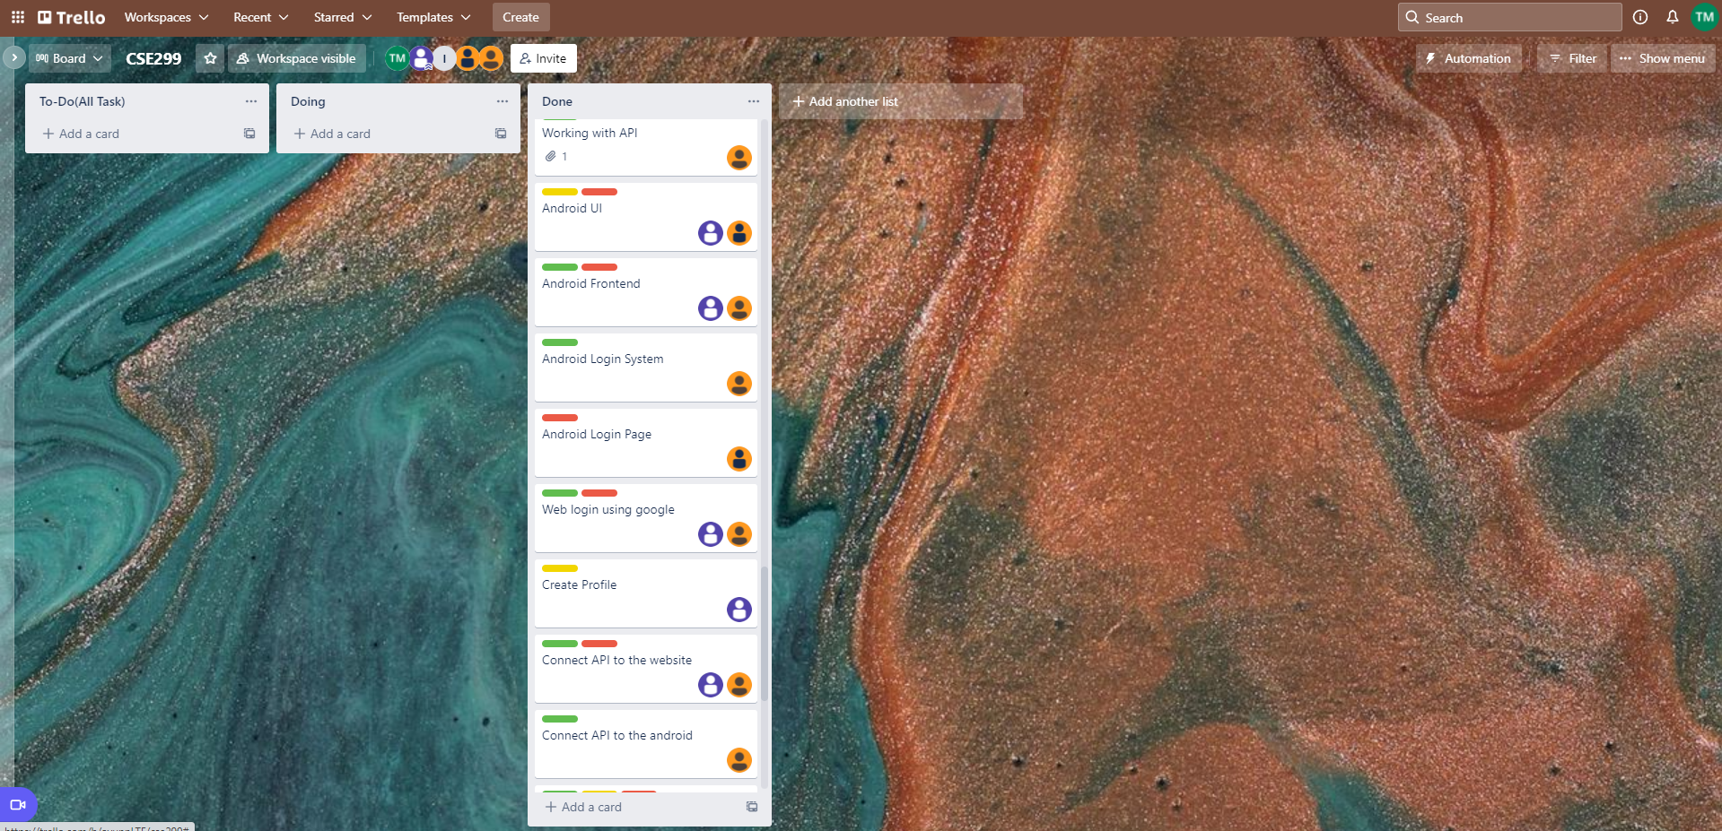
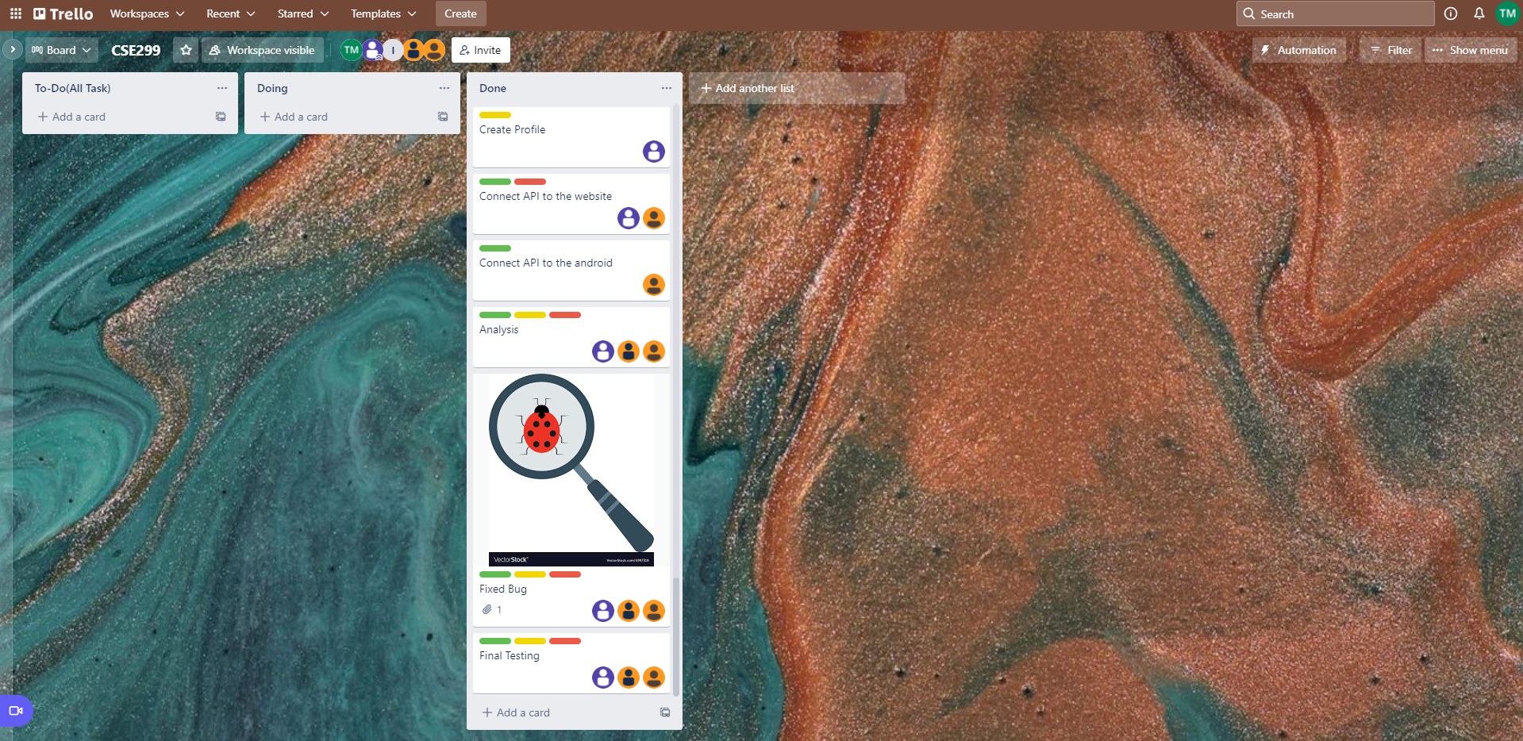
TrelloBoard ScreenShot

Slide 11
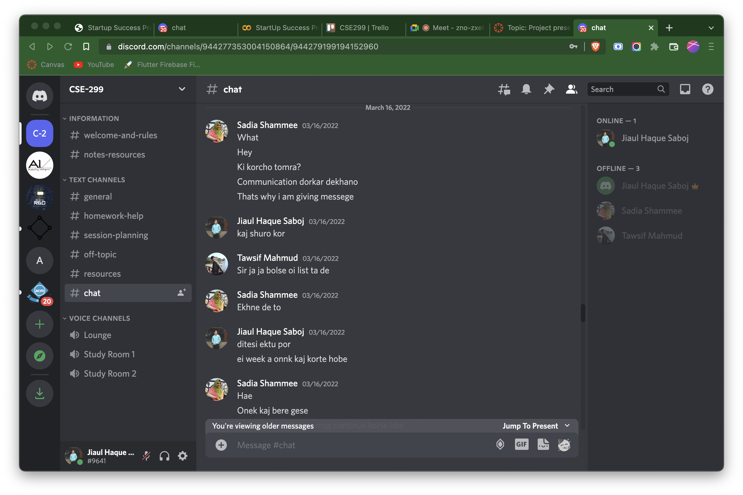
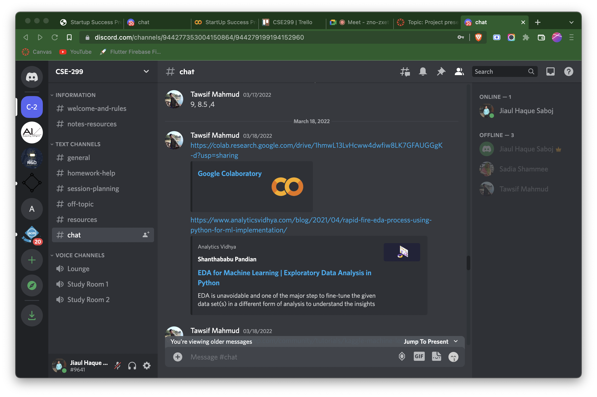
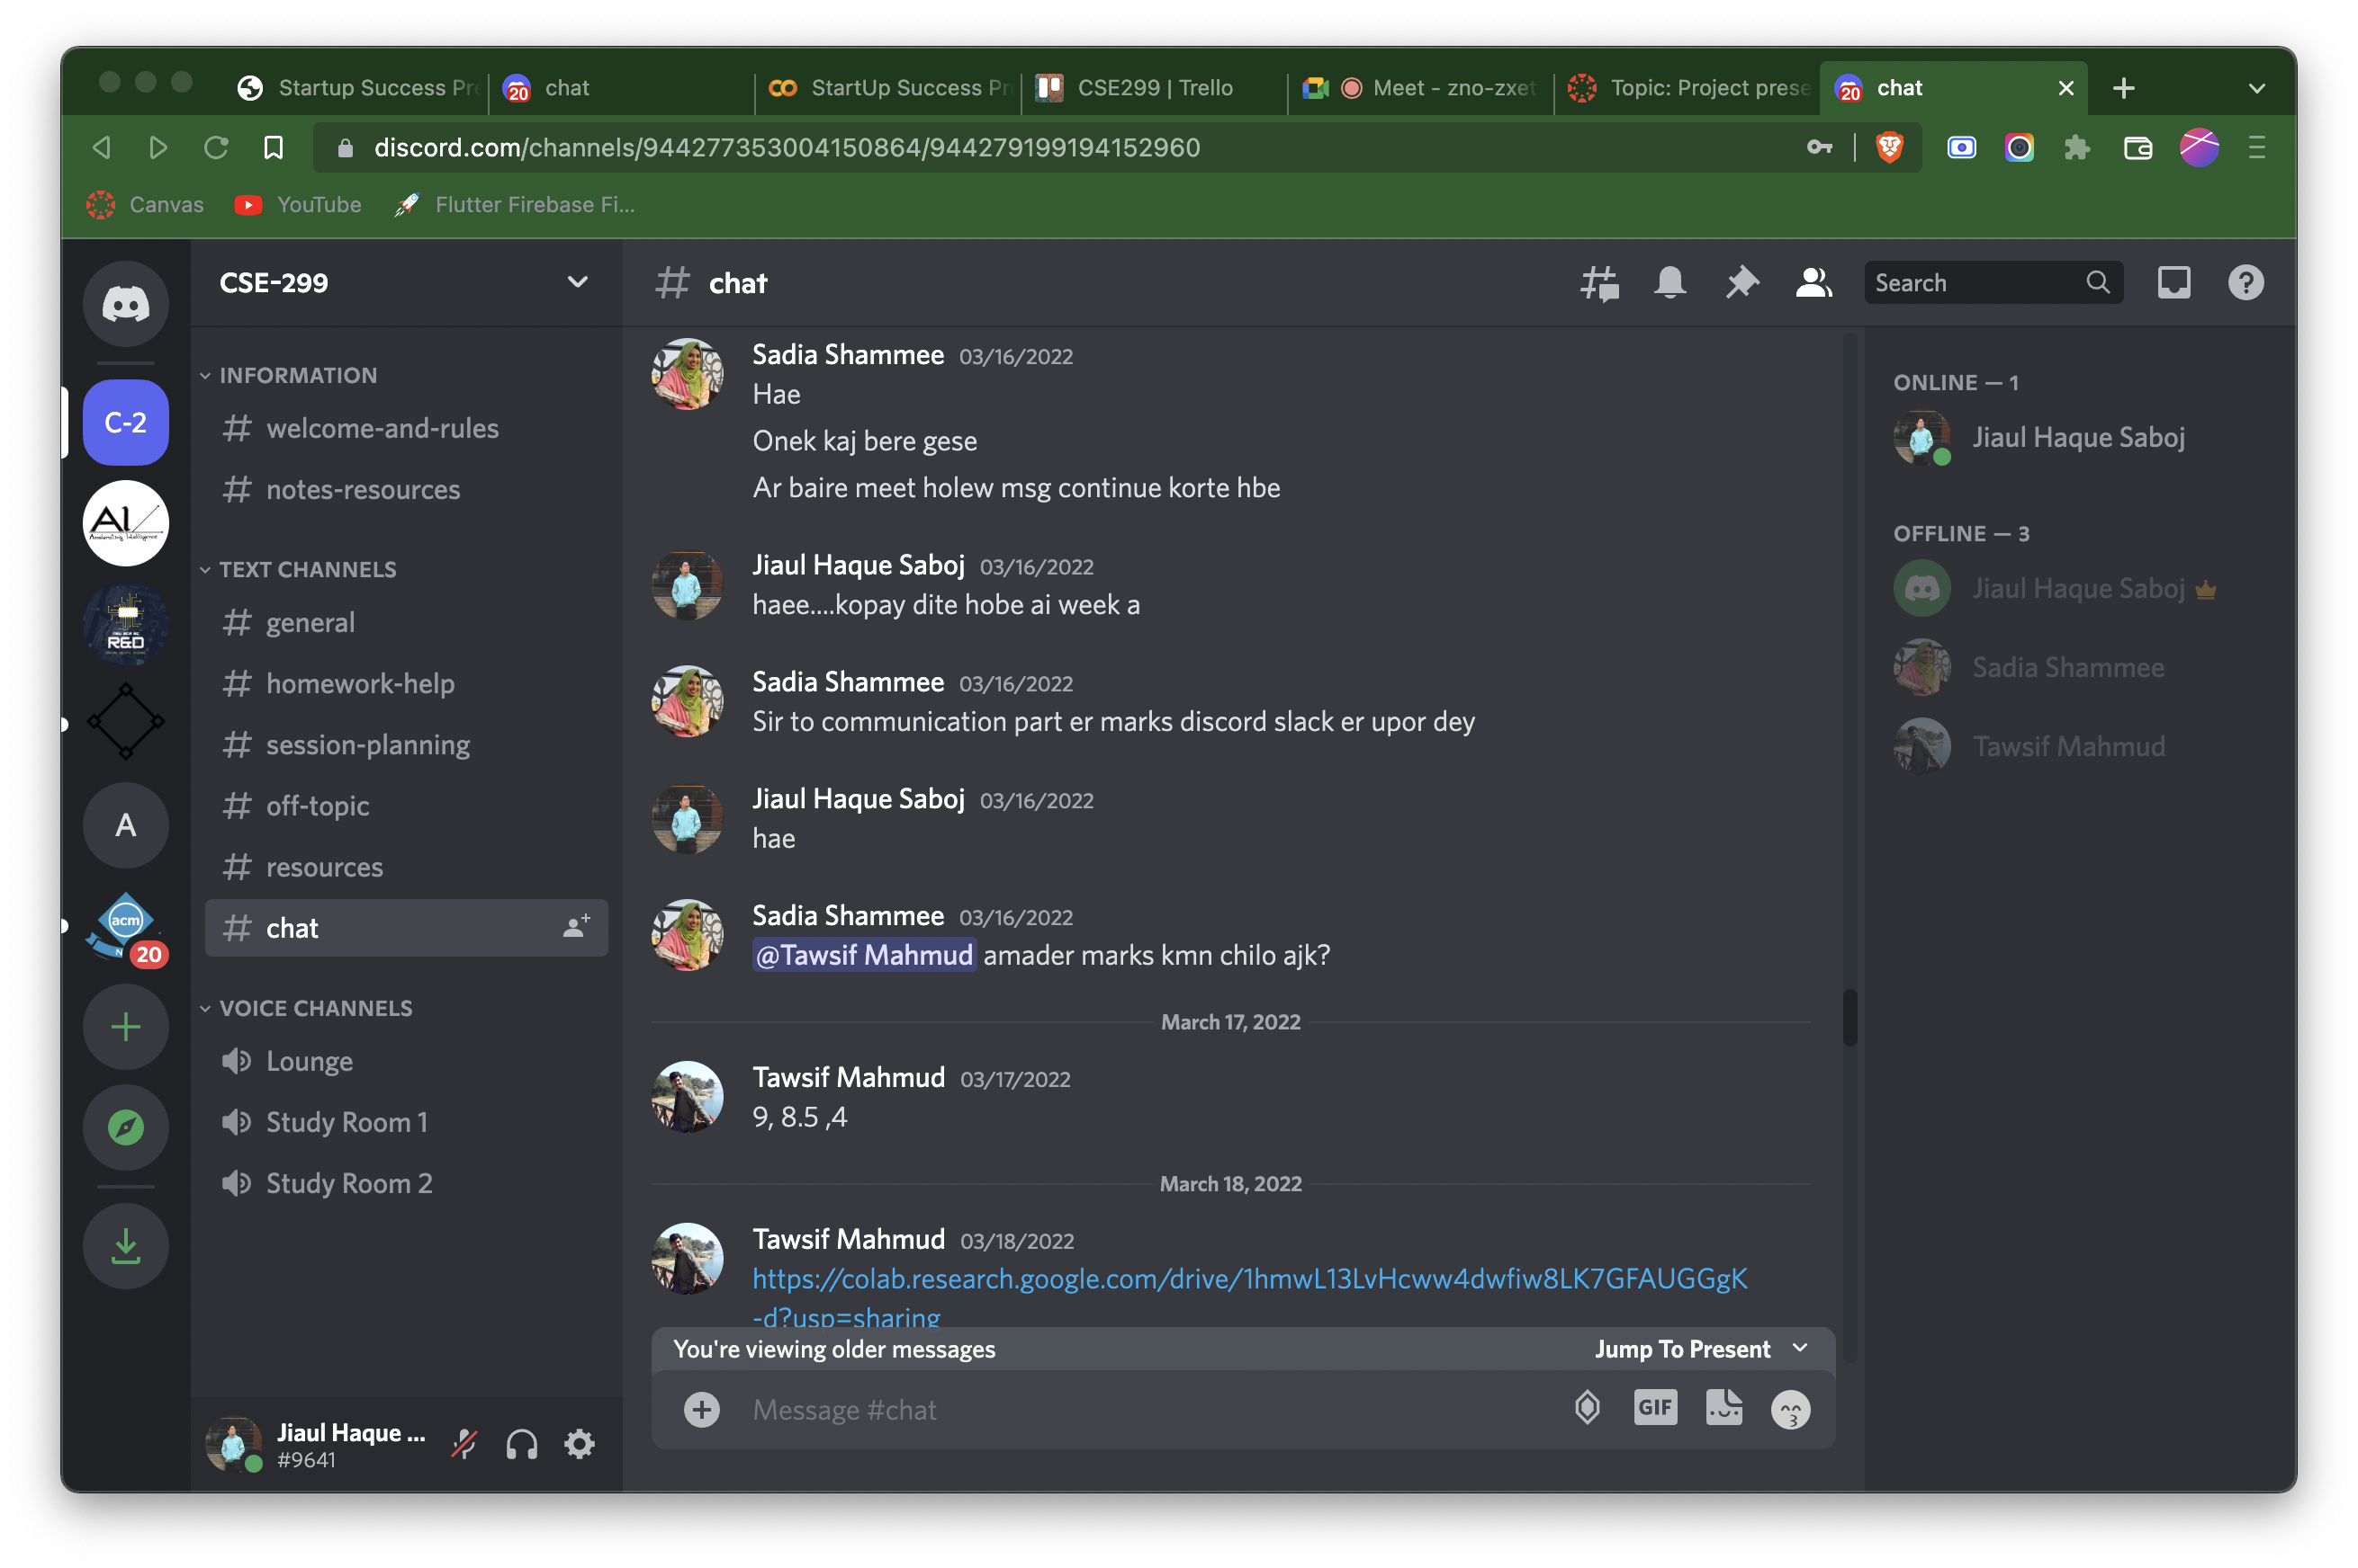
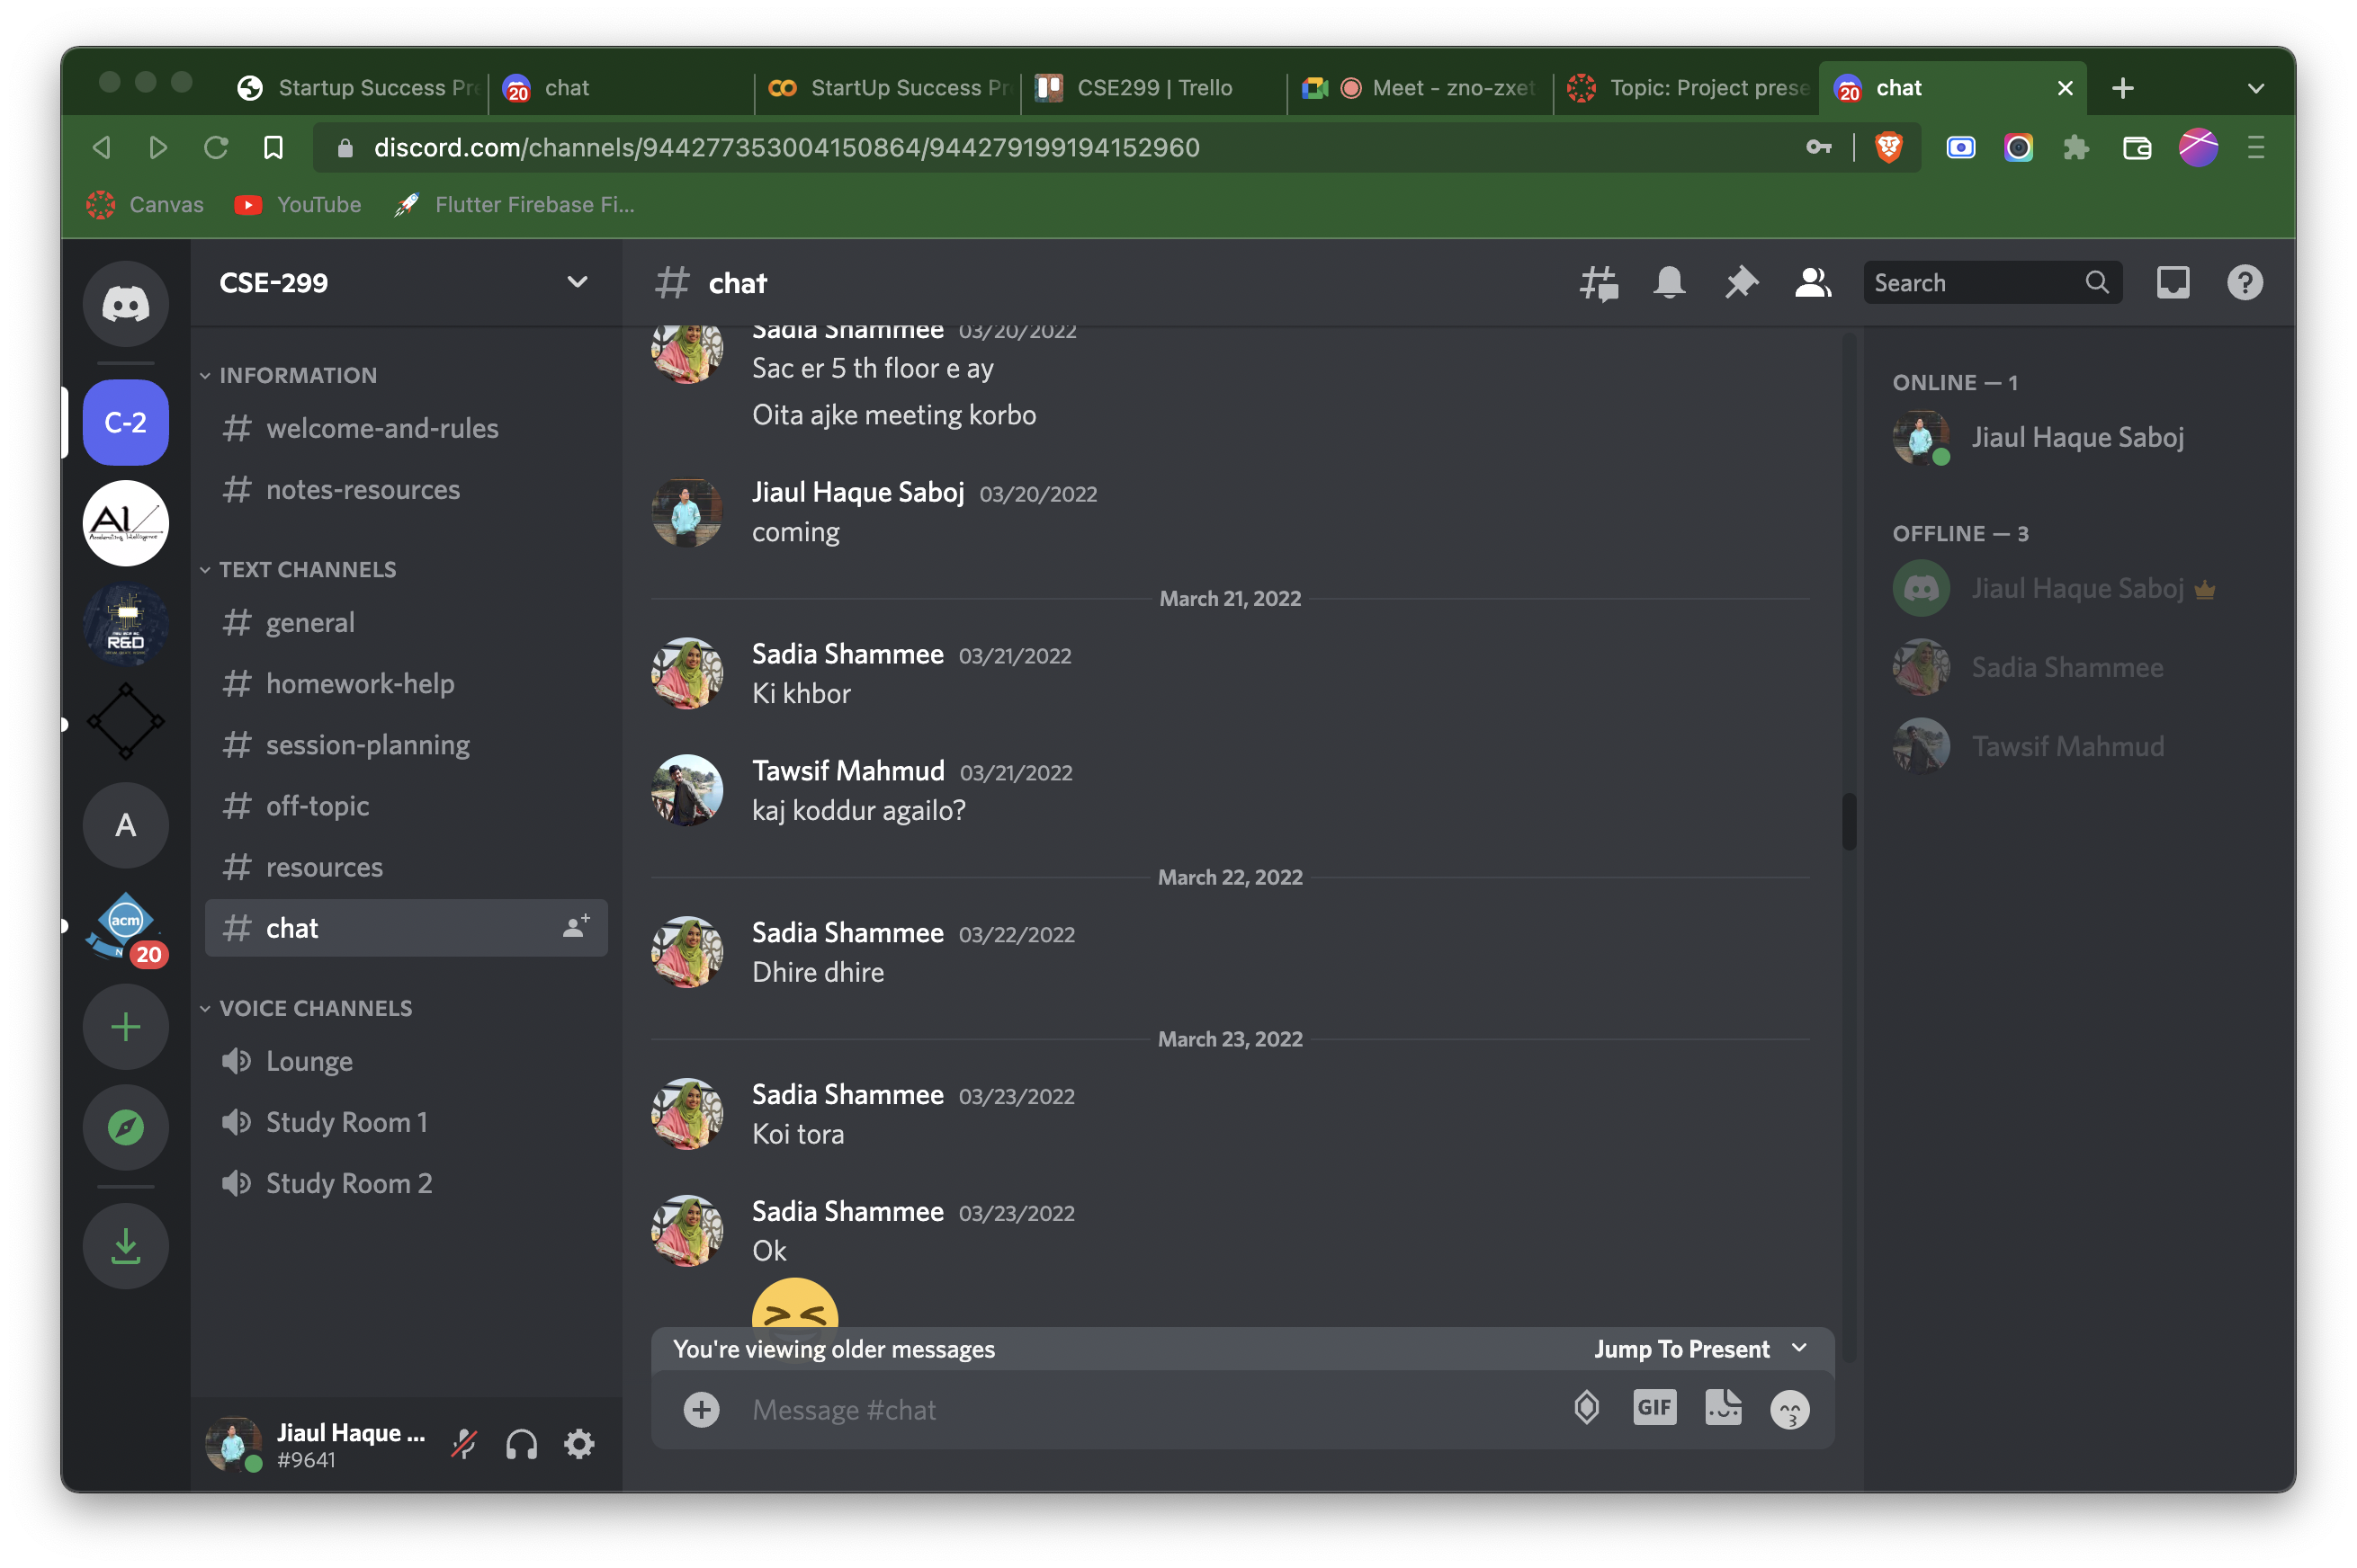
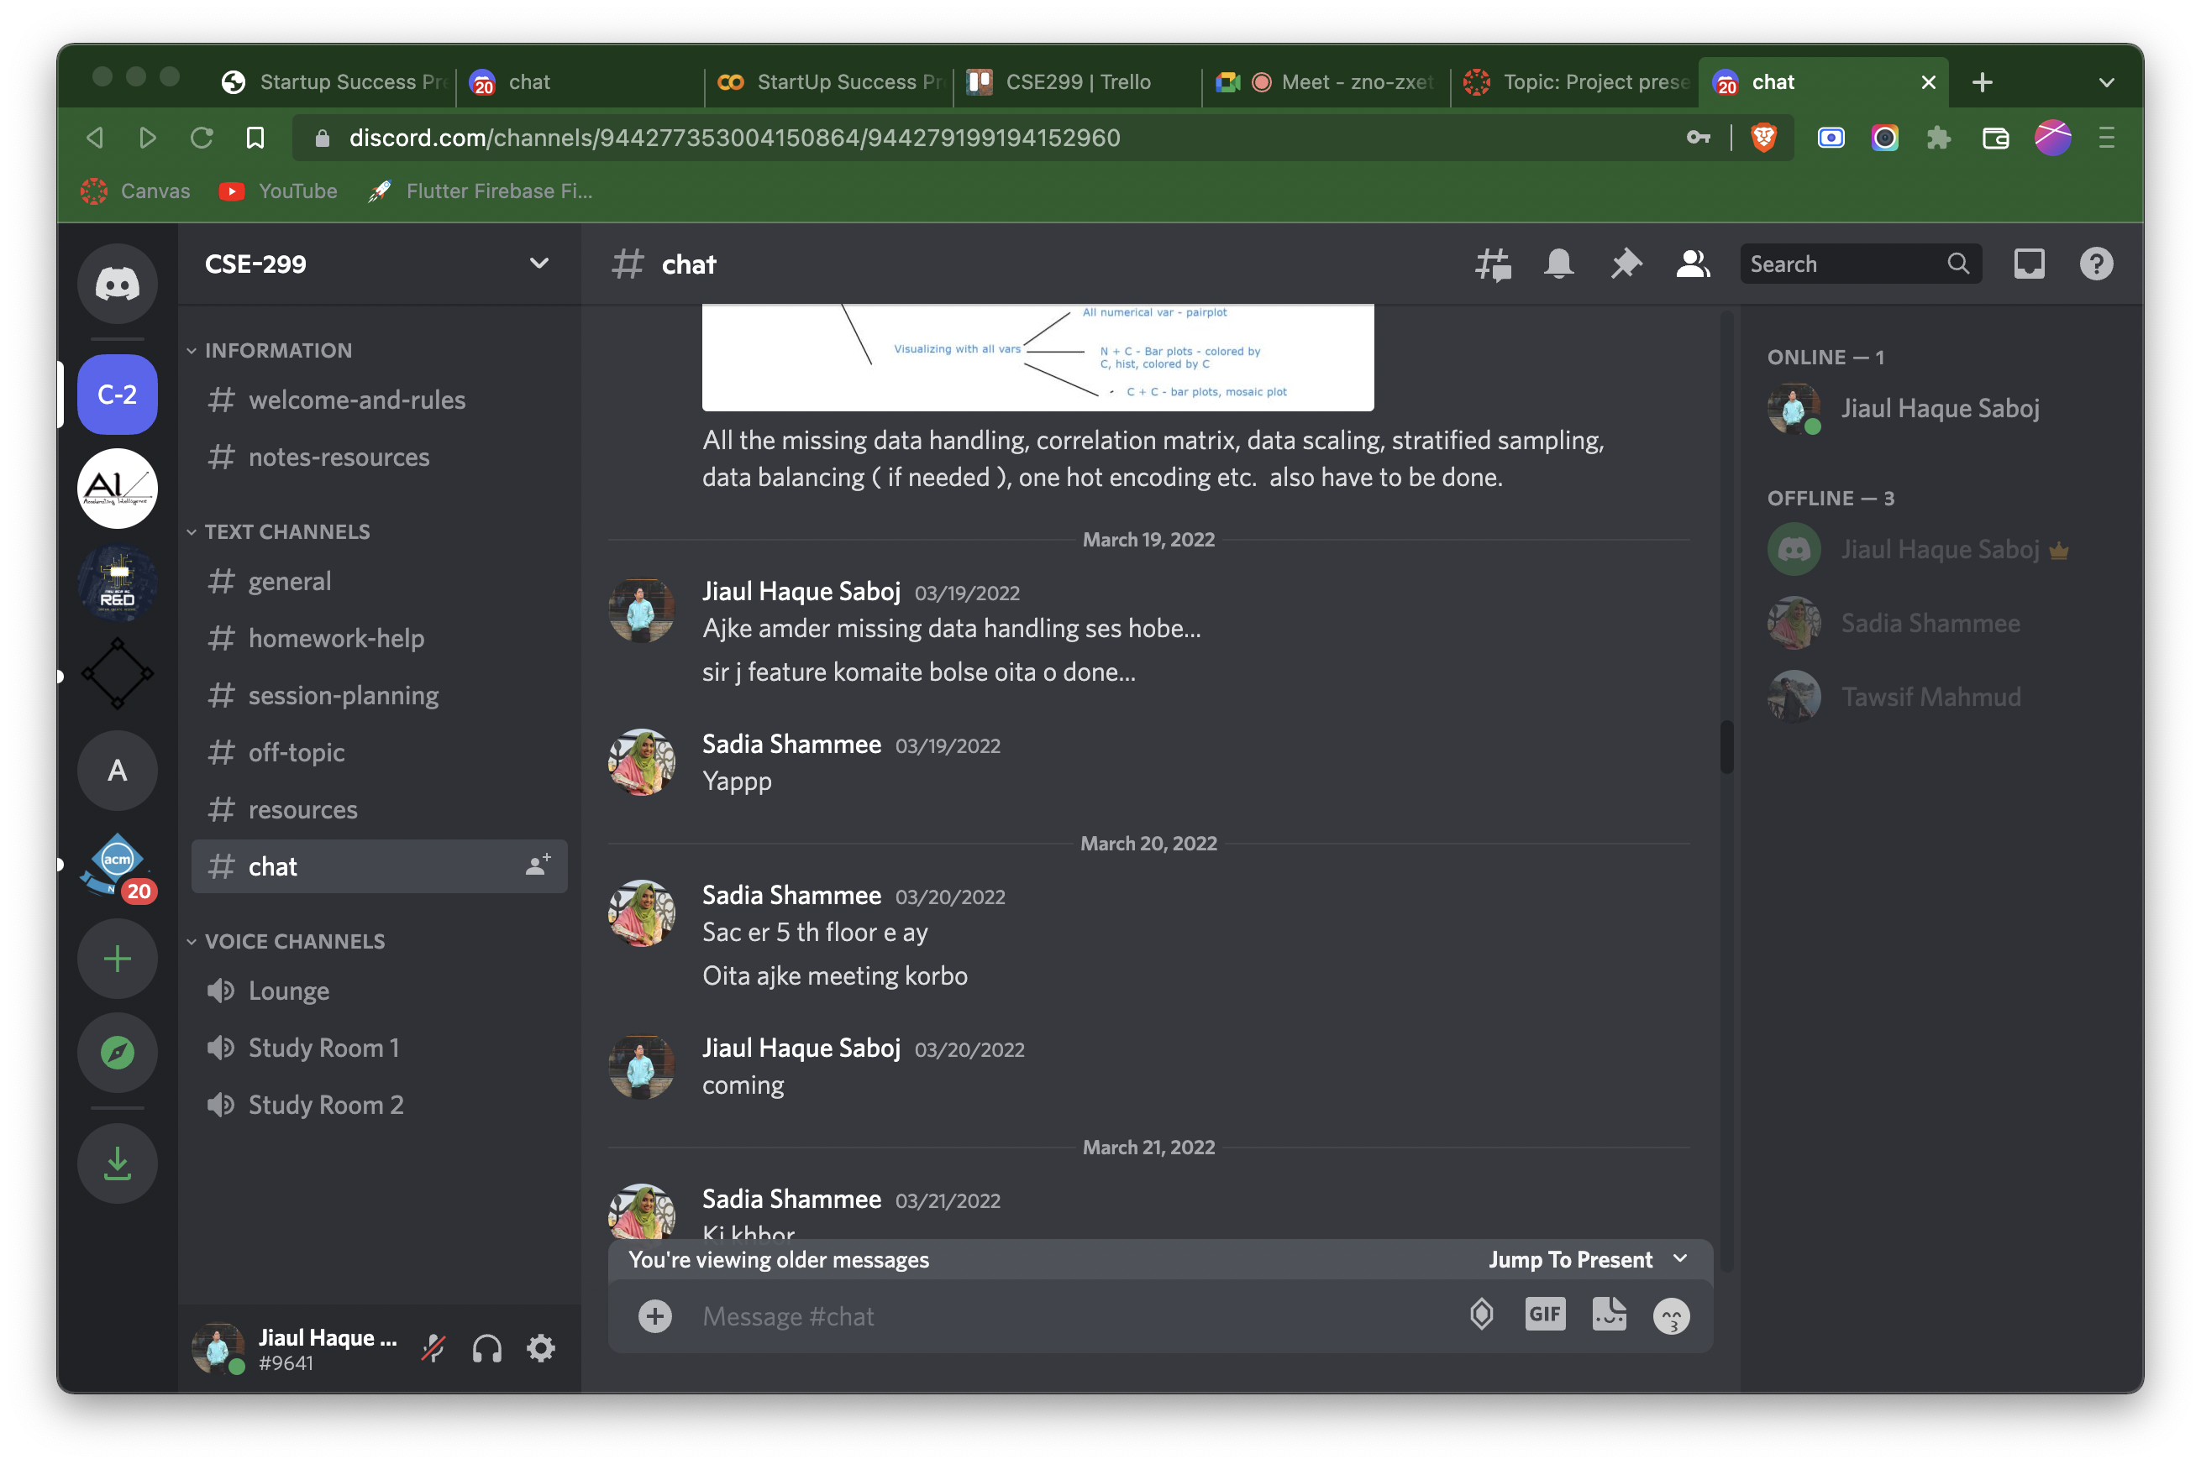
Discord’s Chat Screenshot

Slide 12
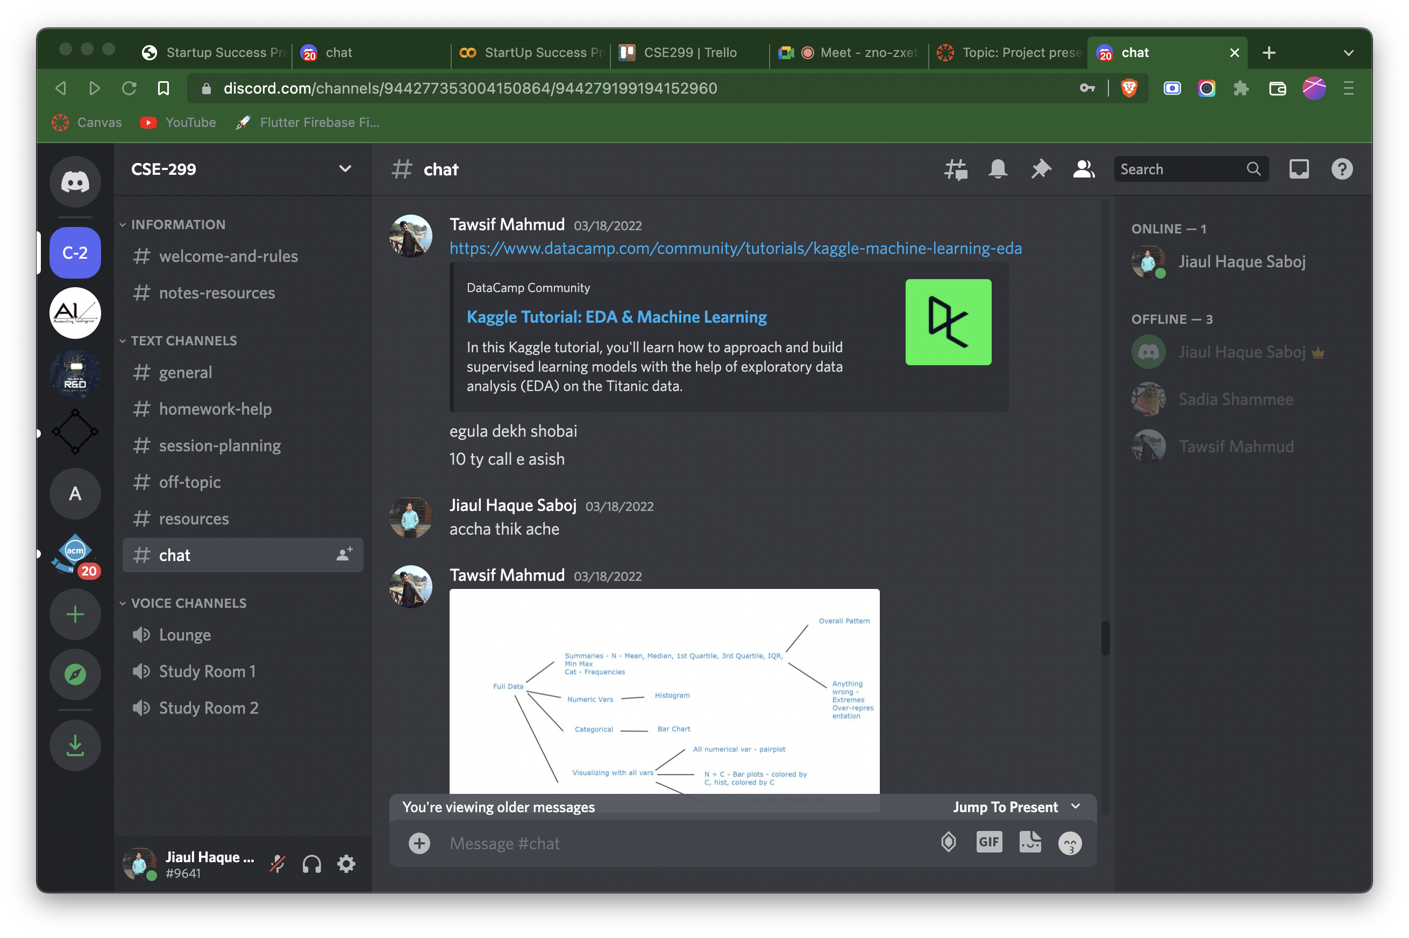
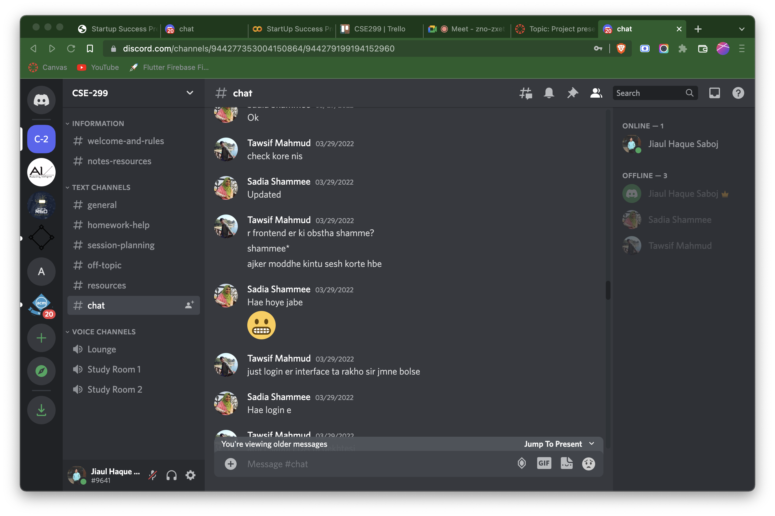
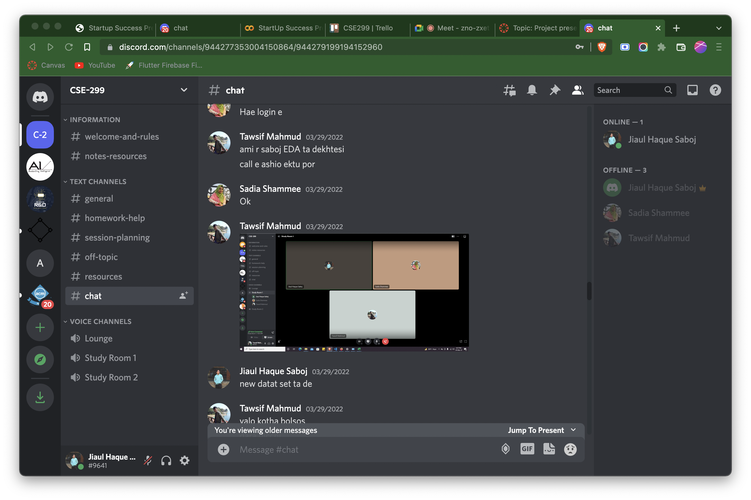
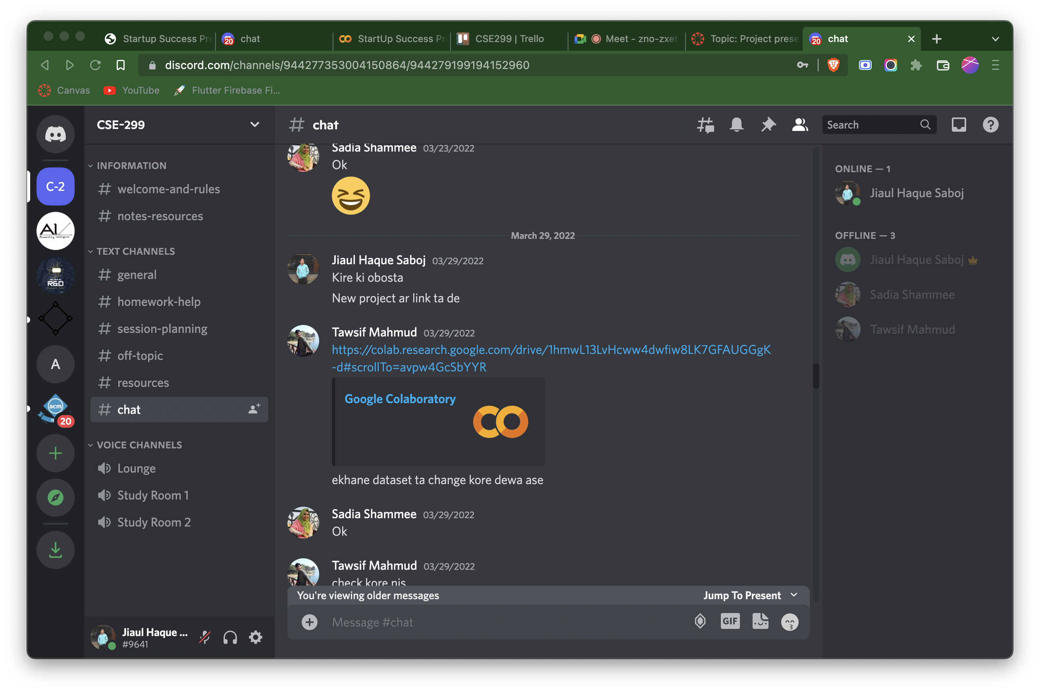
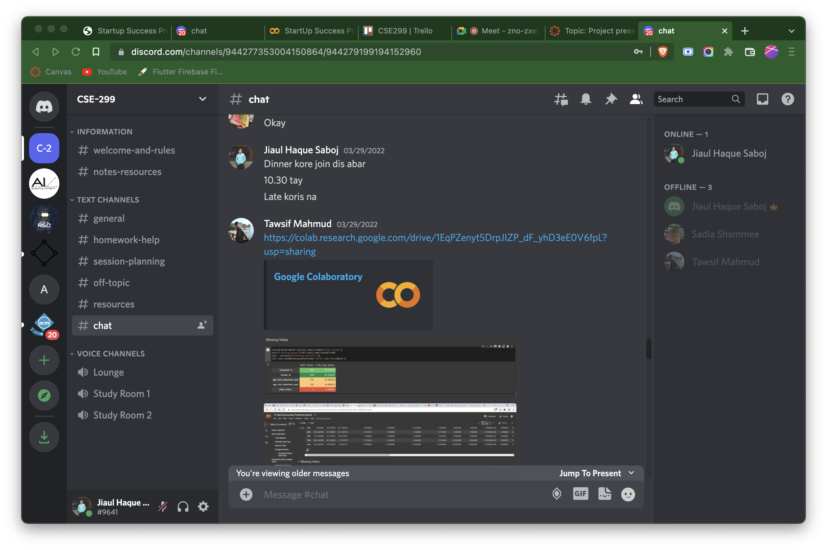
Discord’s Chat Screenshot

Slide 13
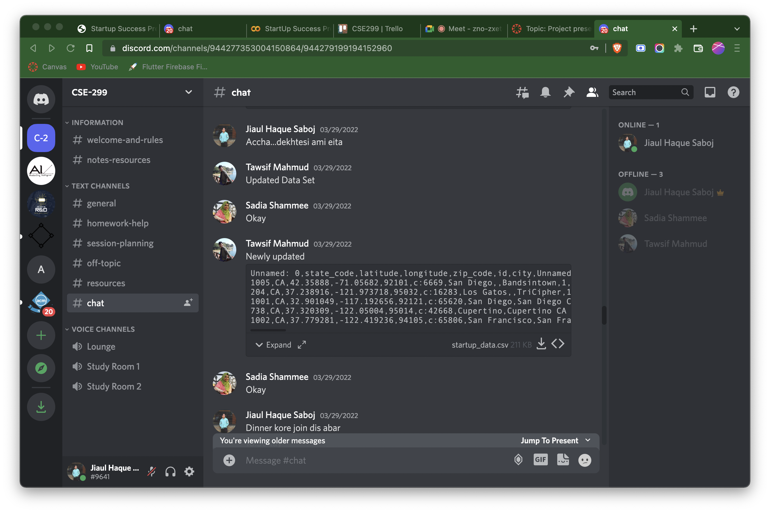
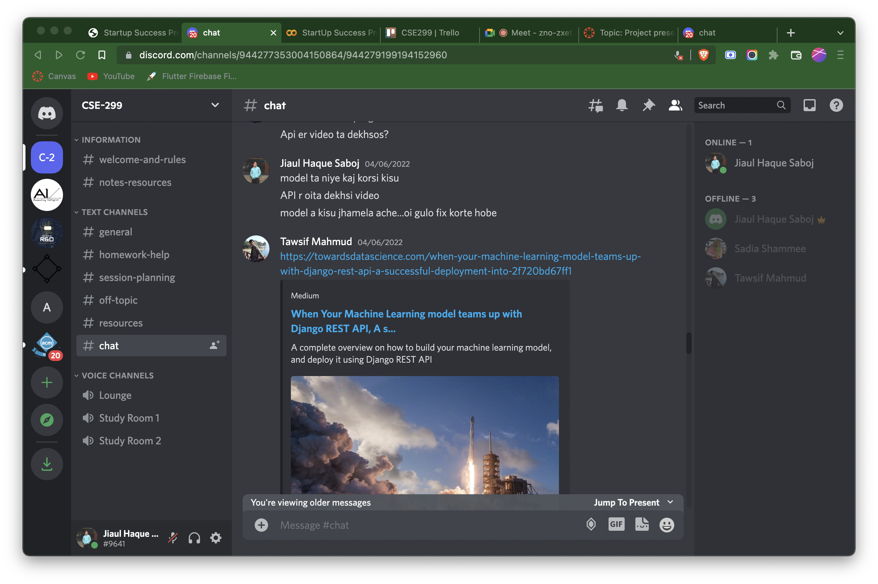
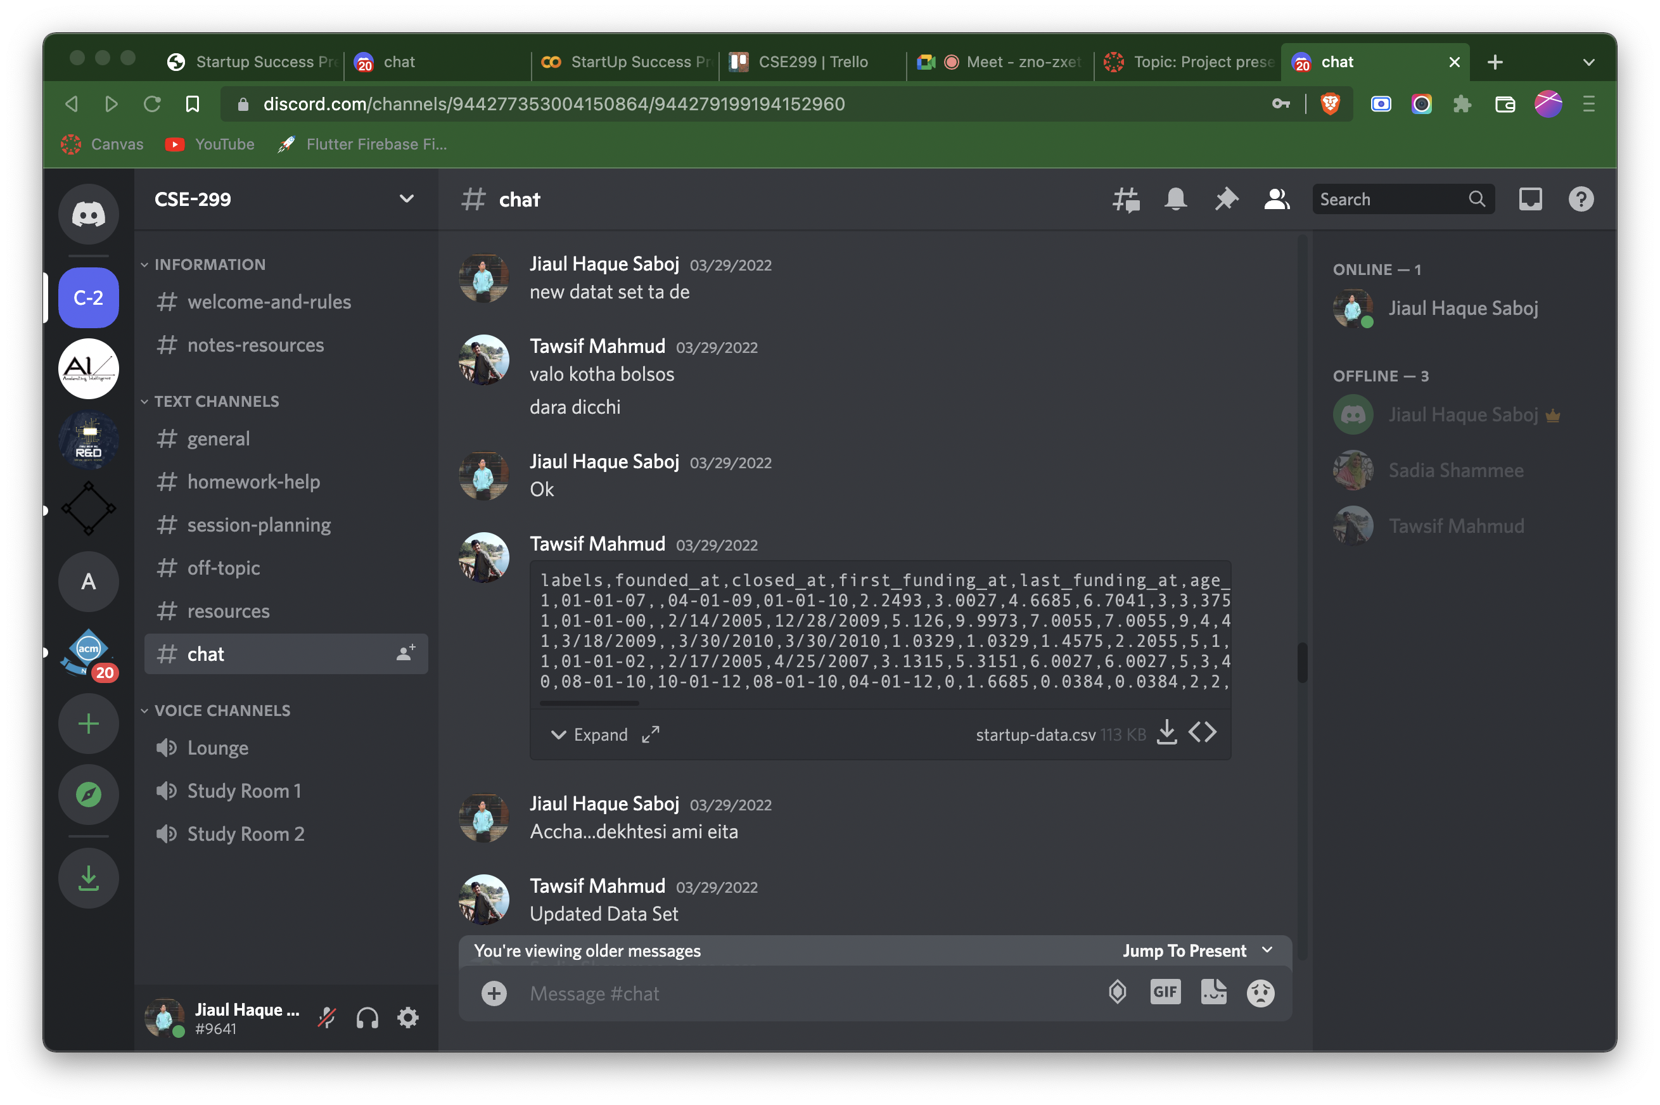
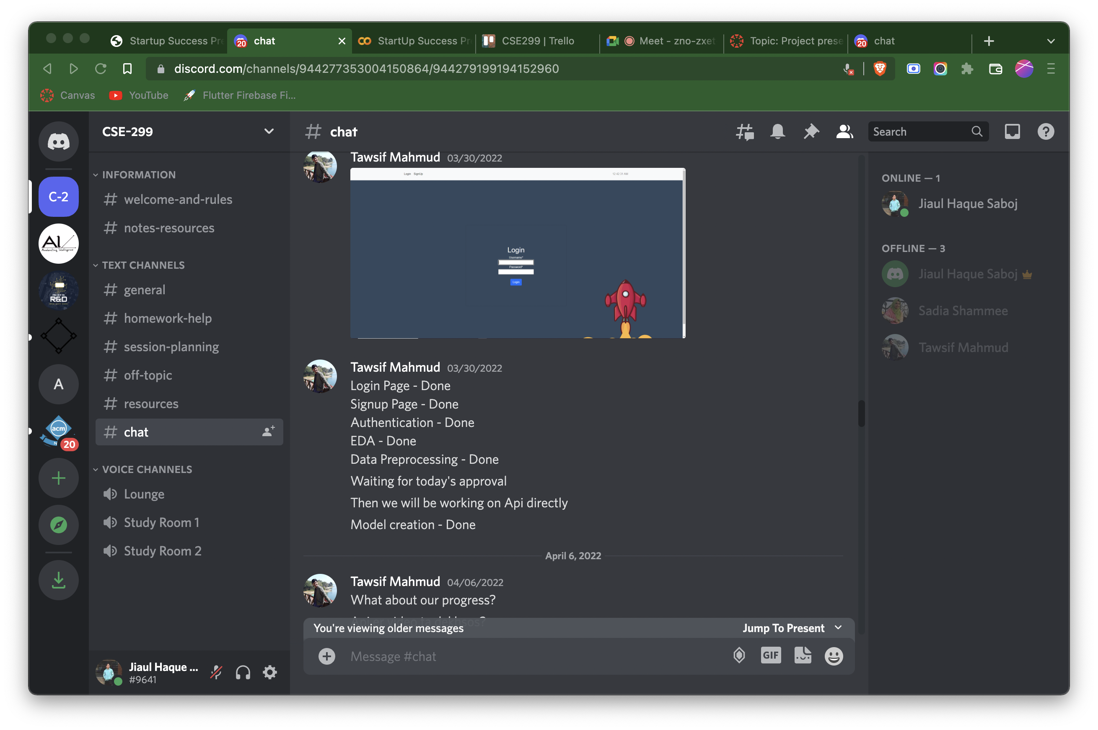
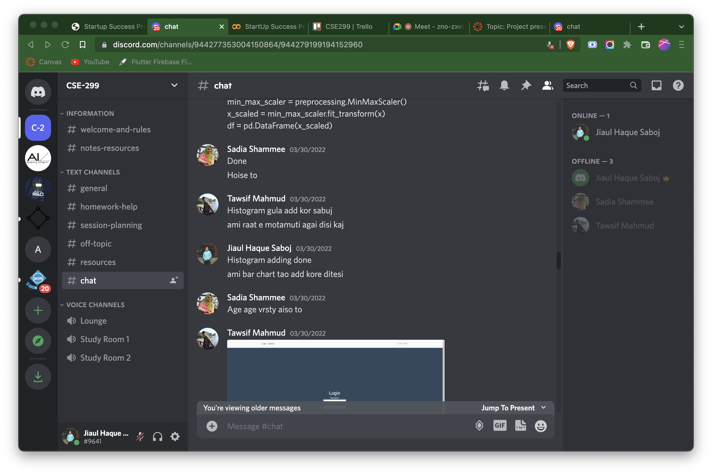
Discord’s Chat Screenshot

Slide 14
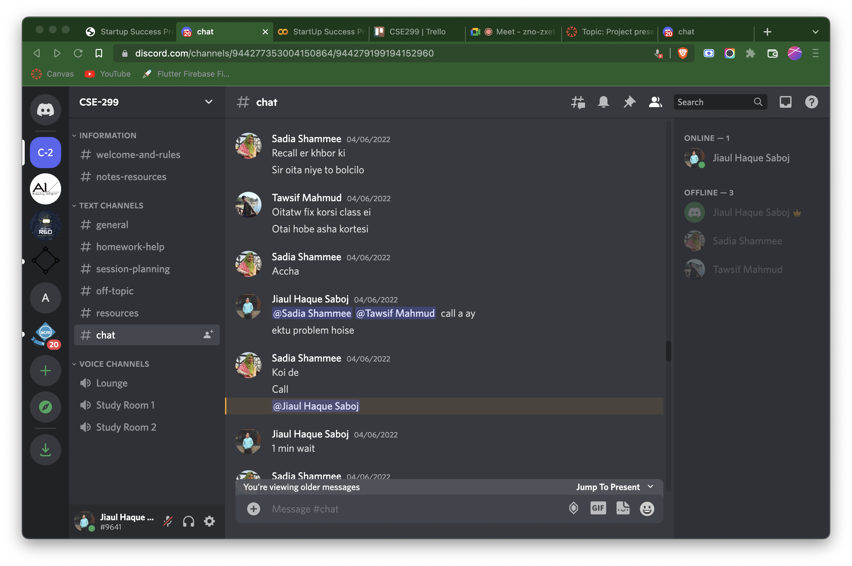
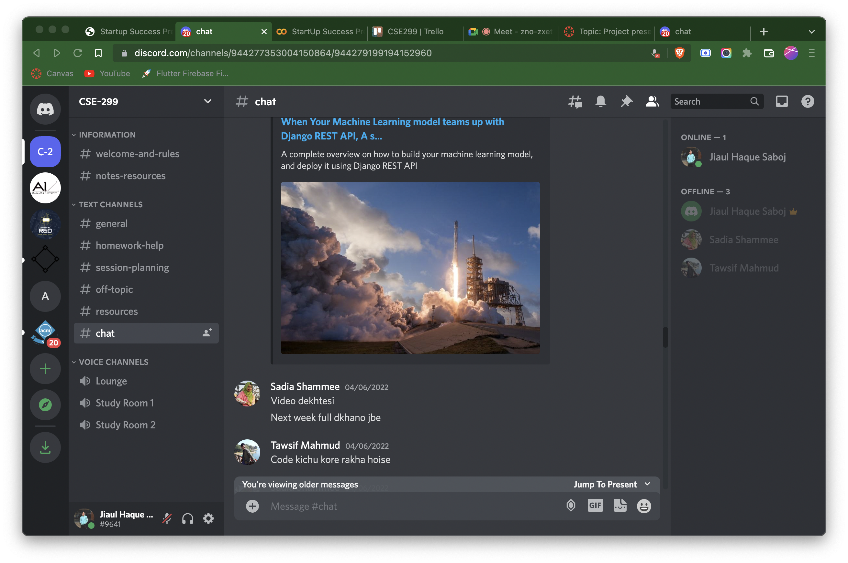
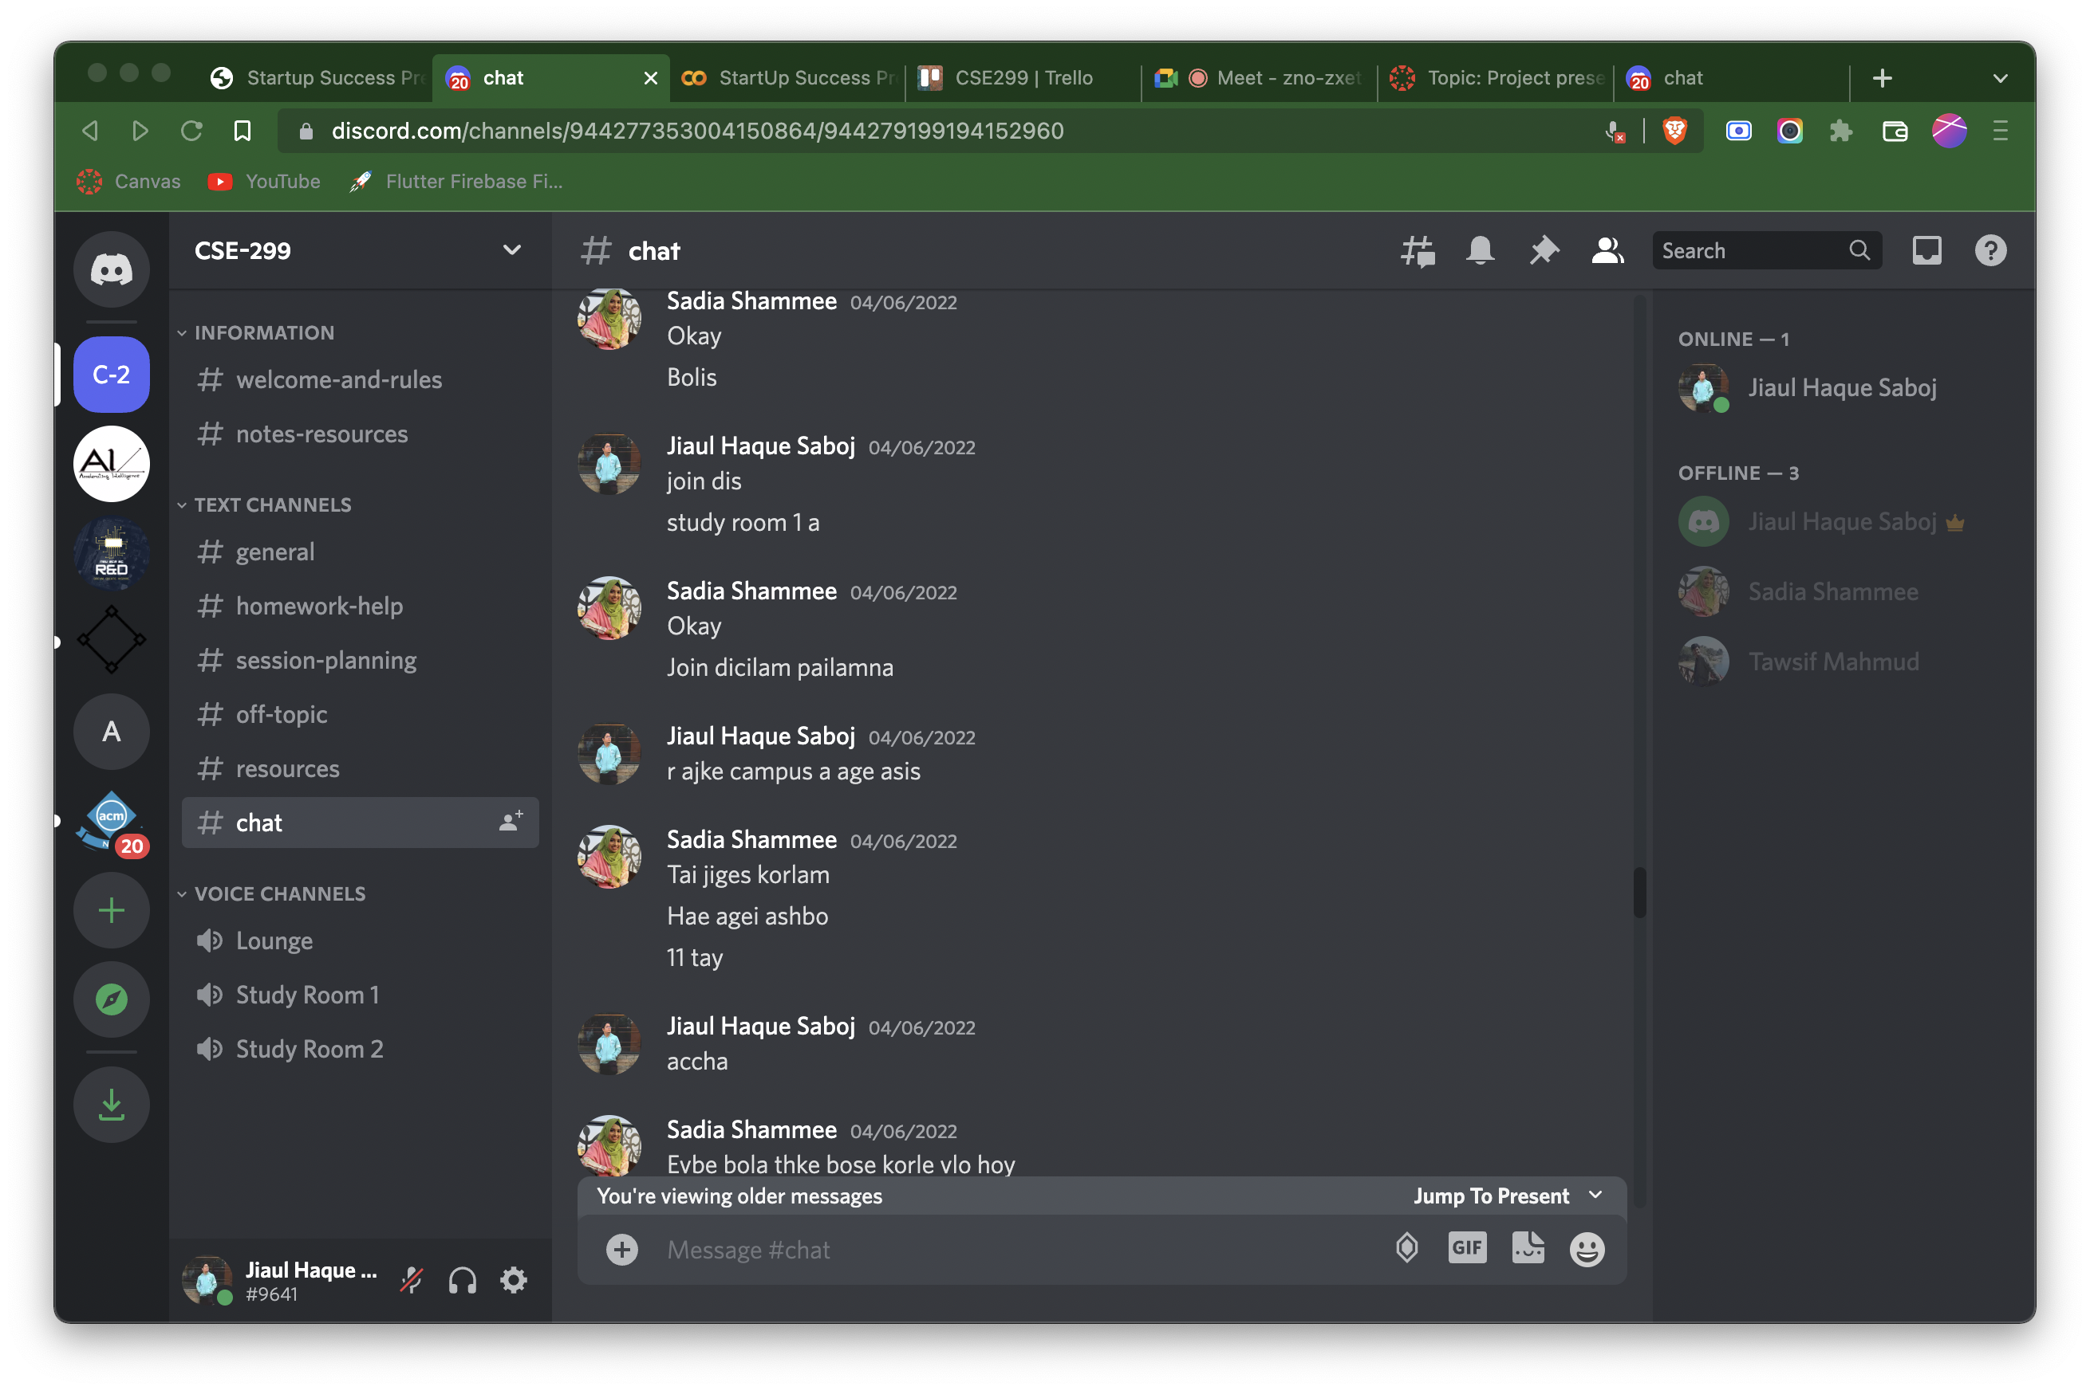
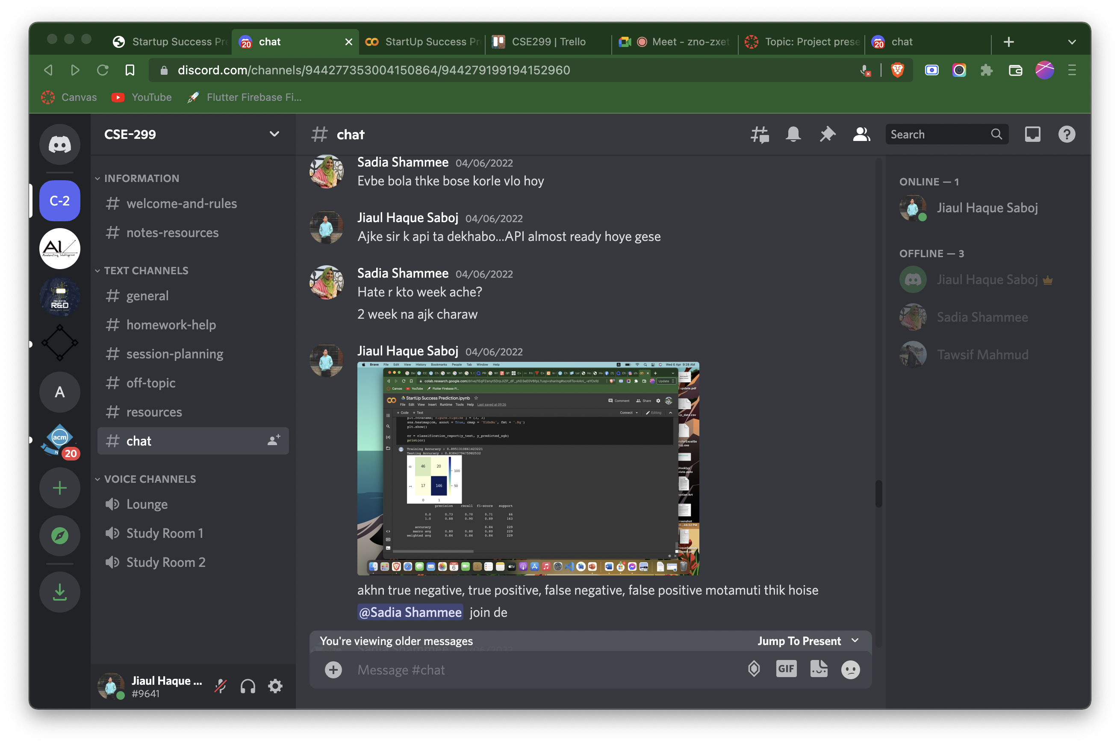
Discord’s Chat Screenshot

Slide 15
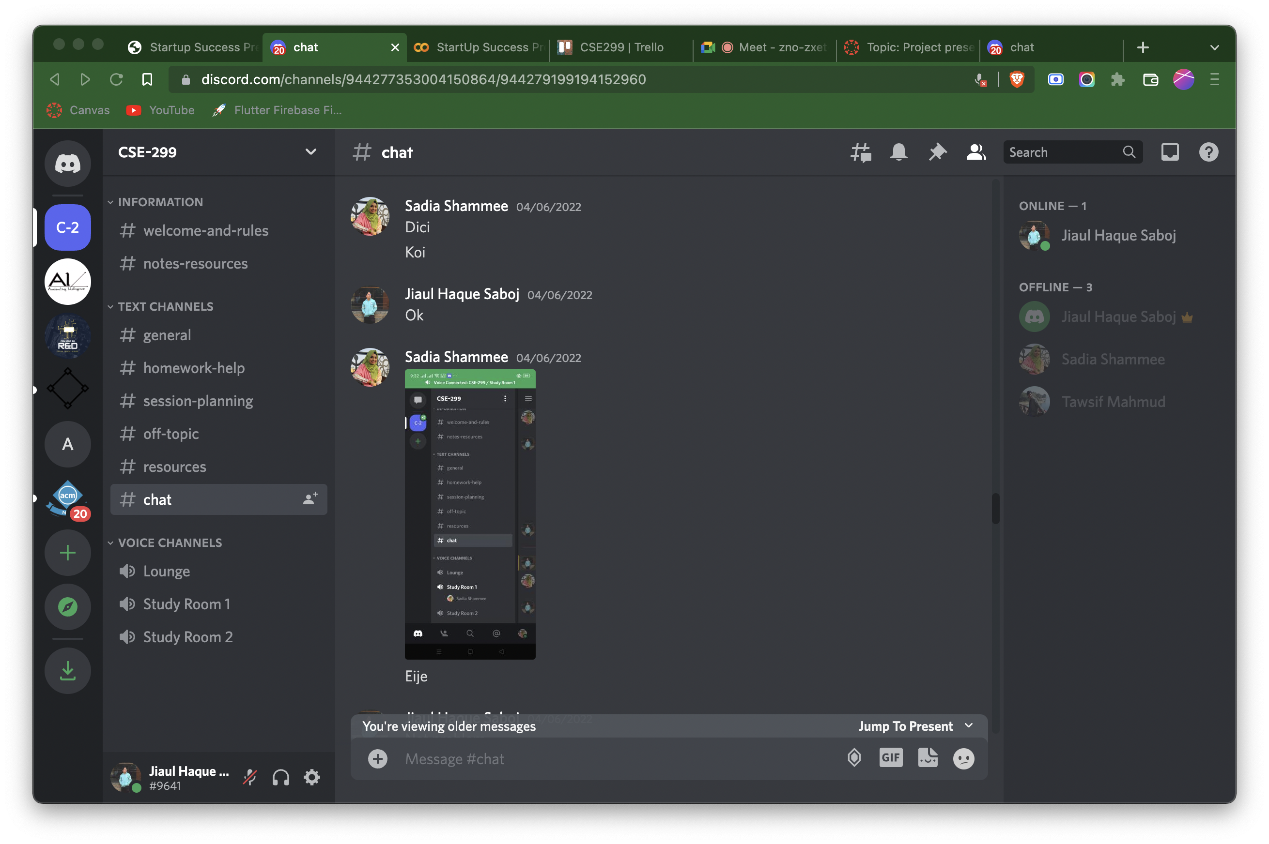
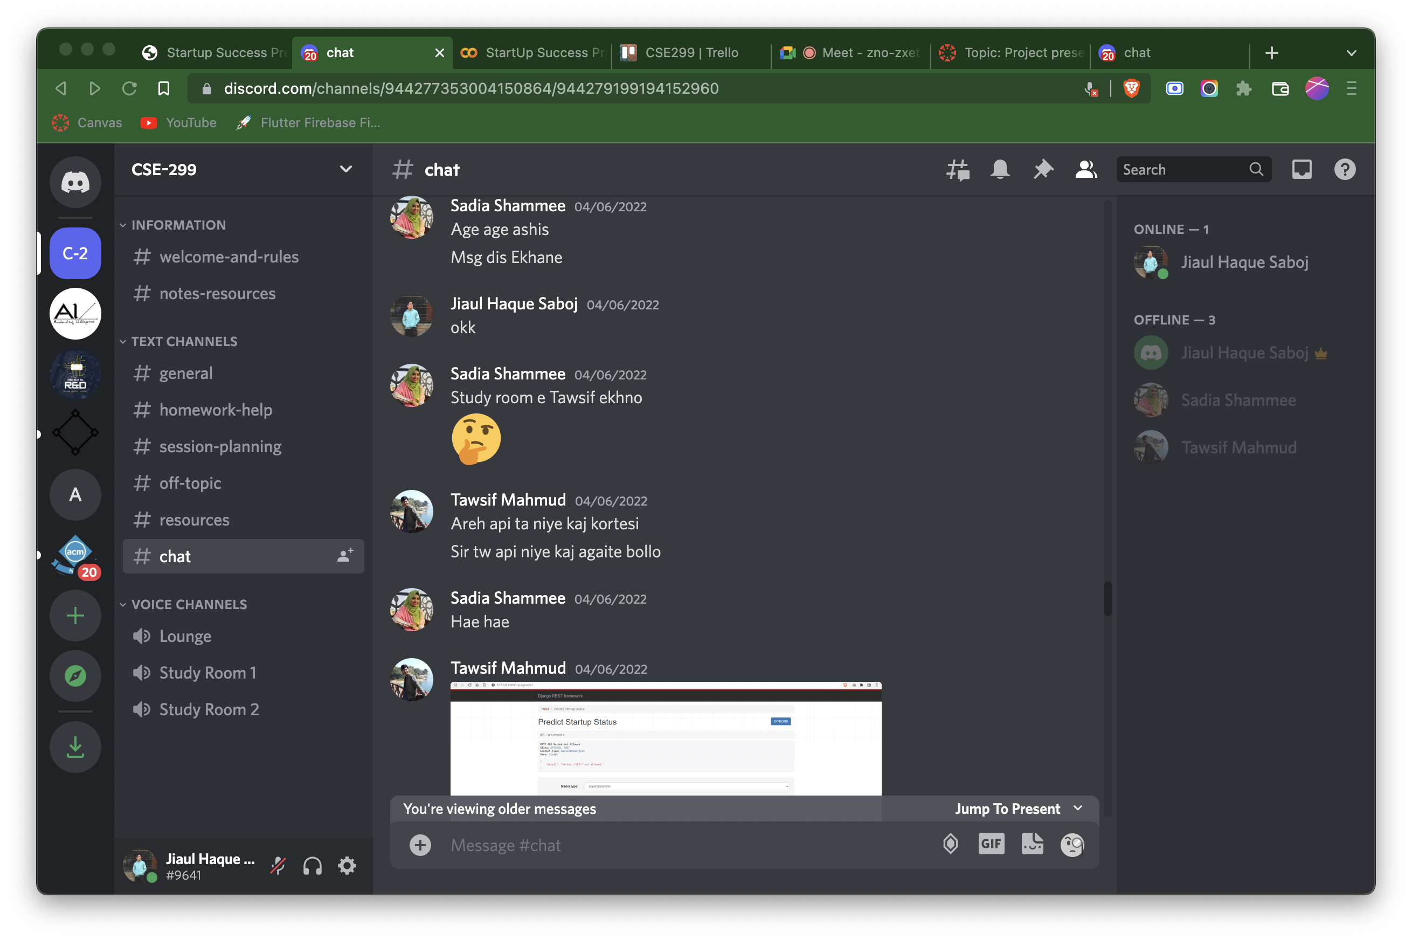
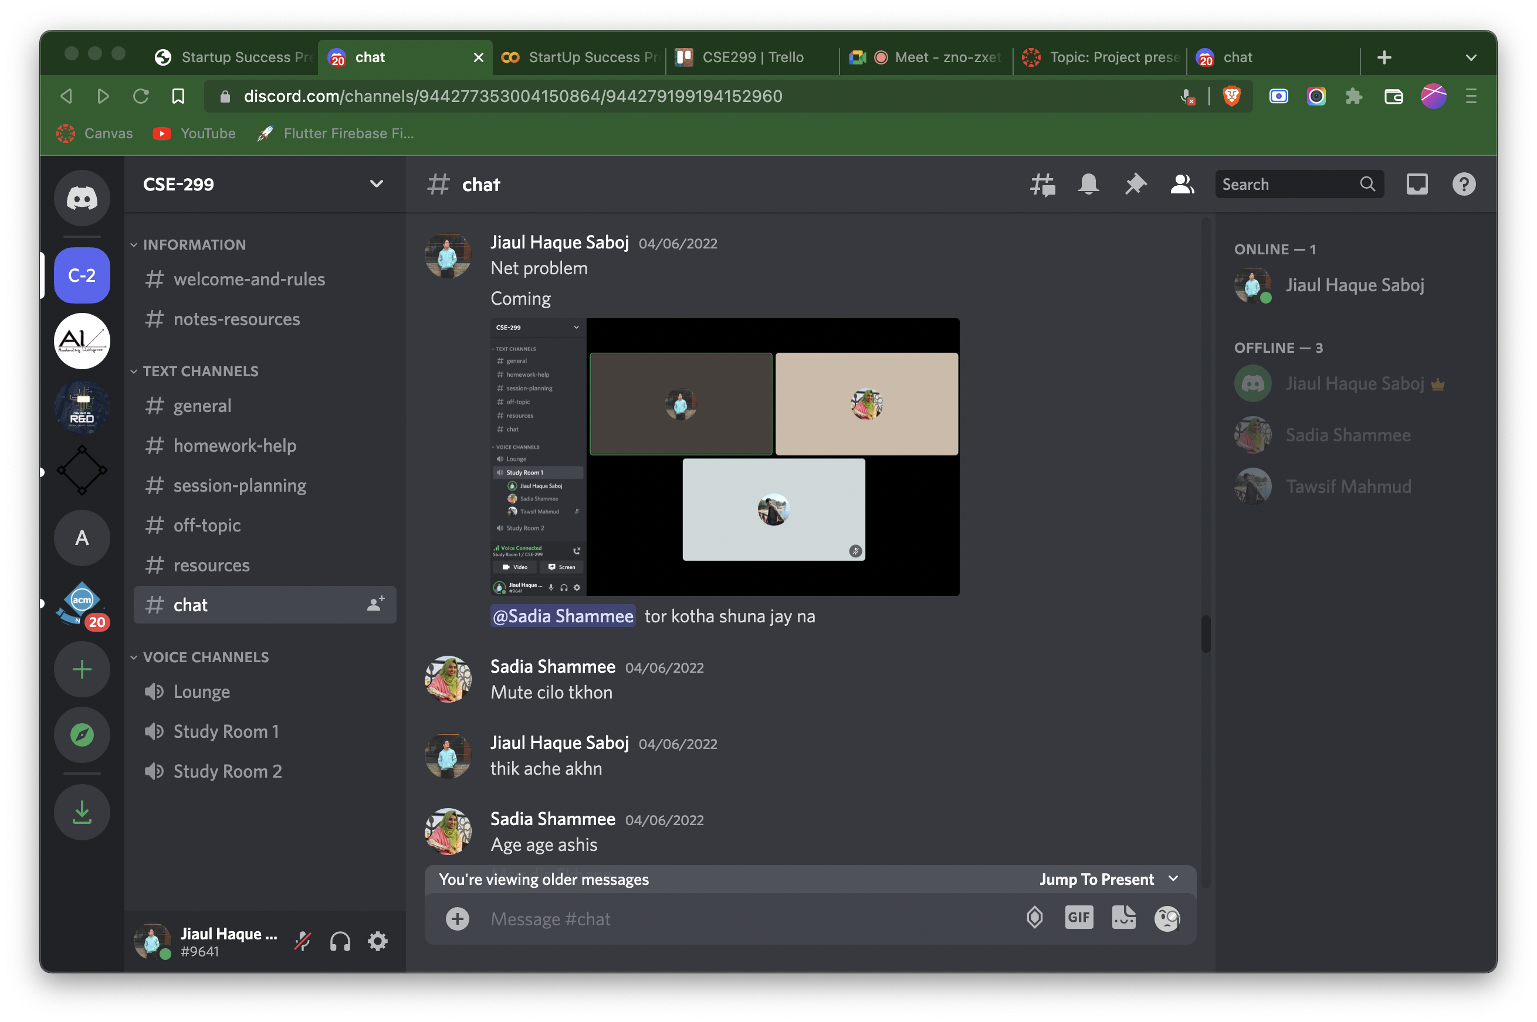
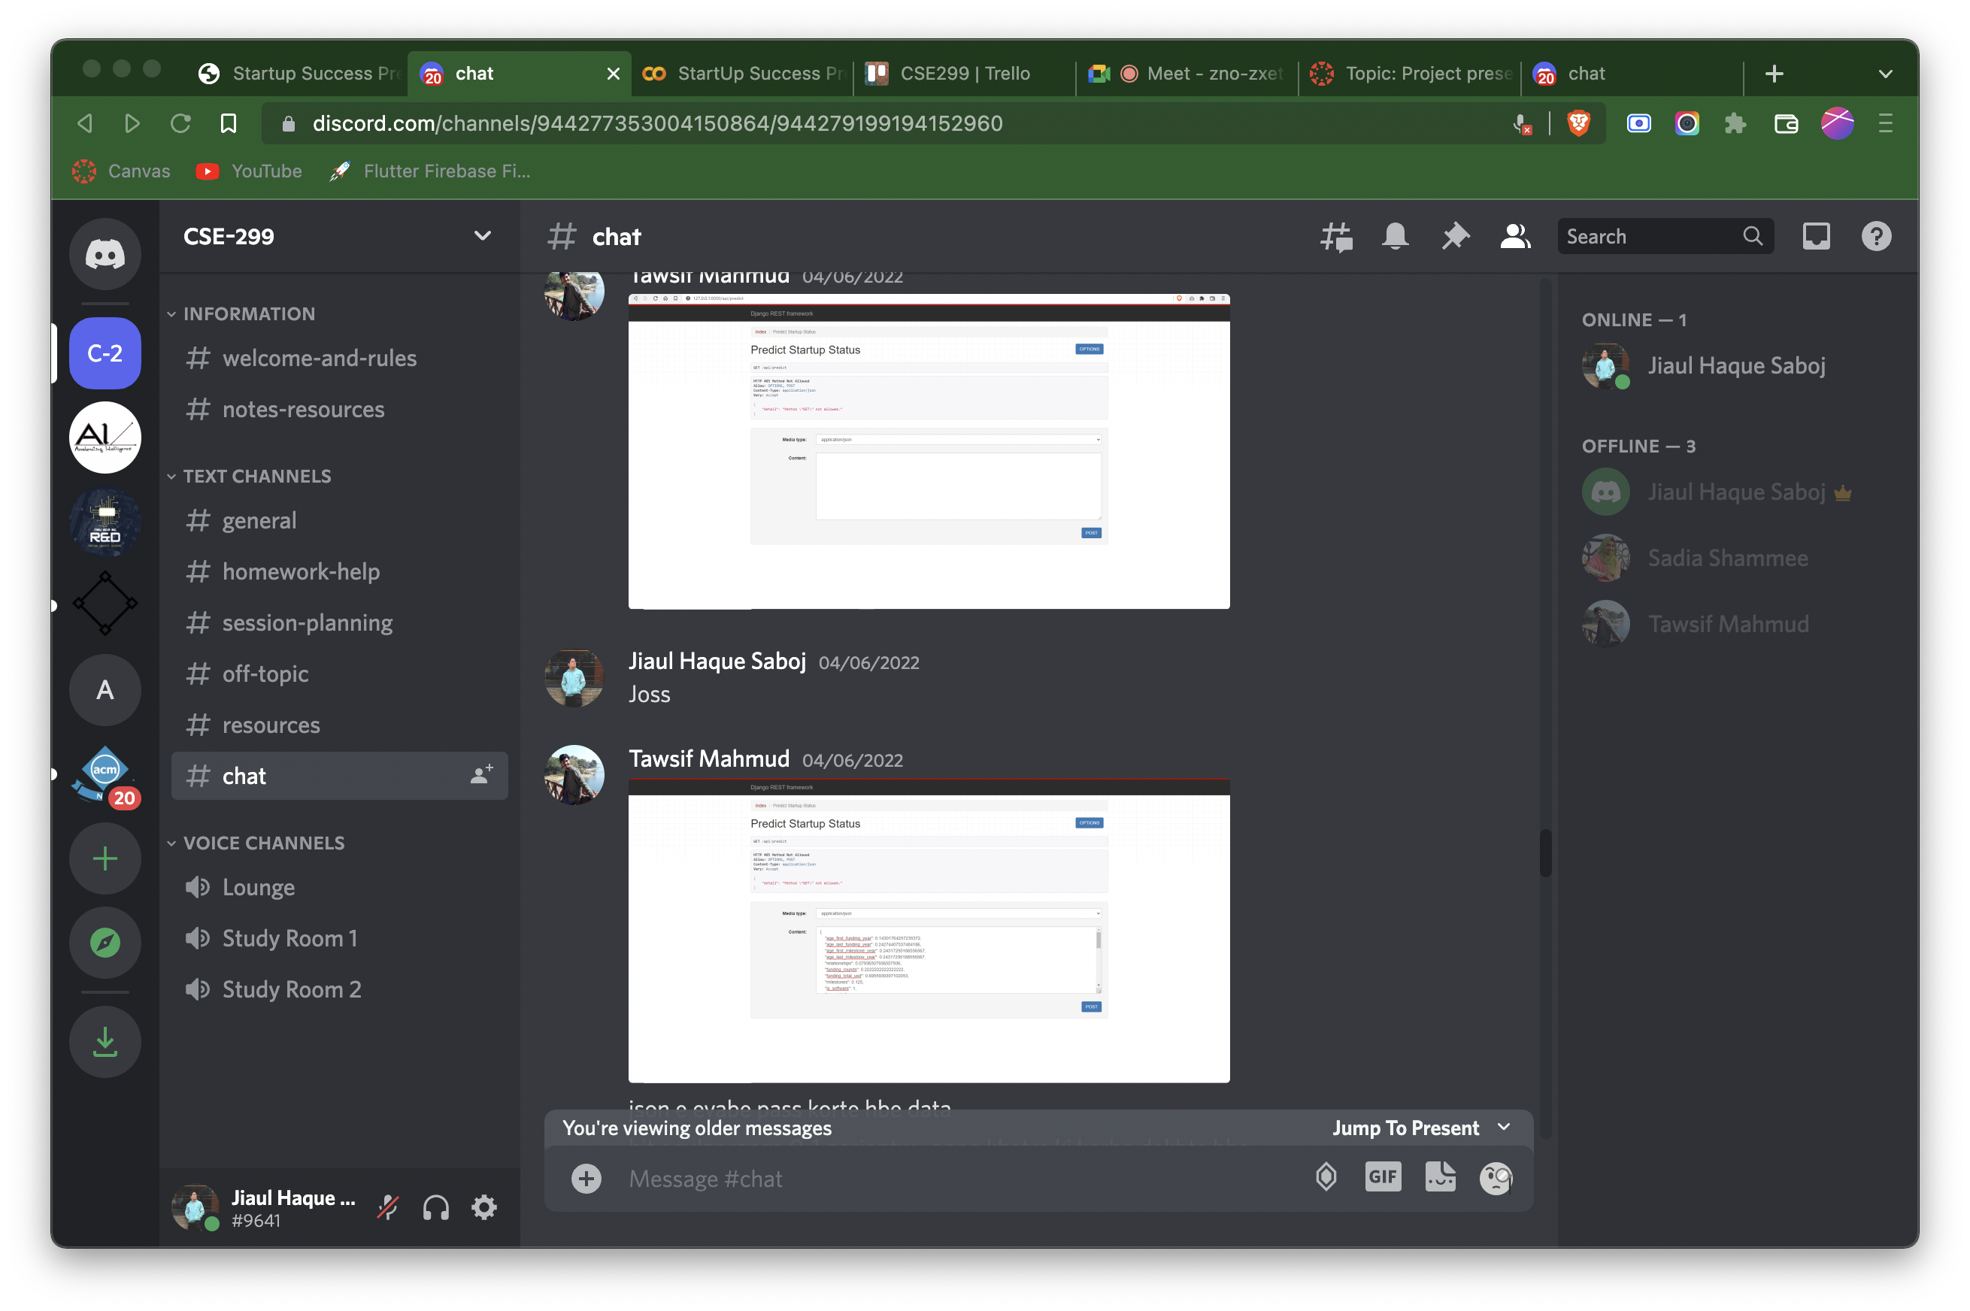
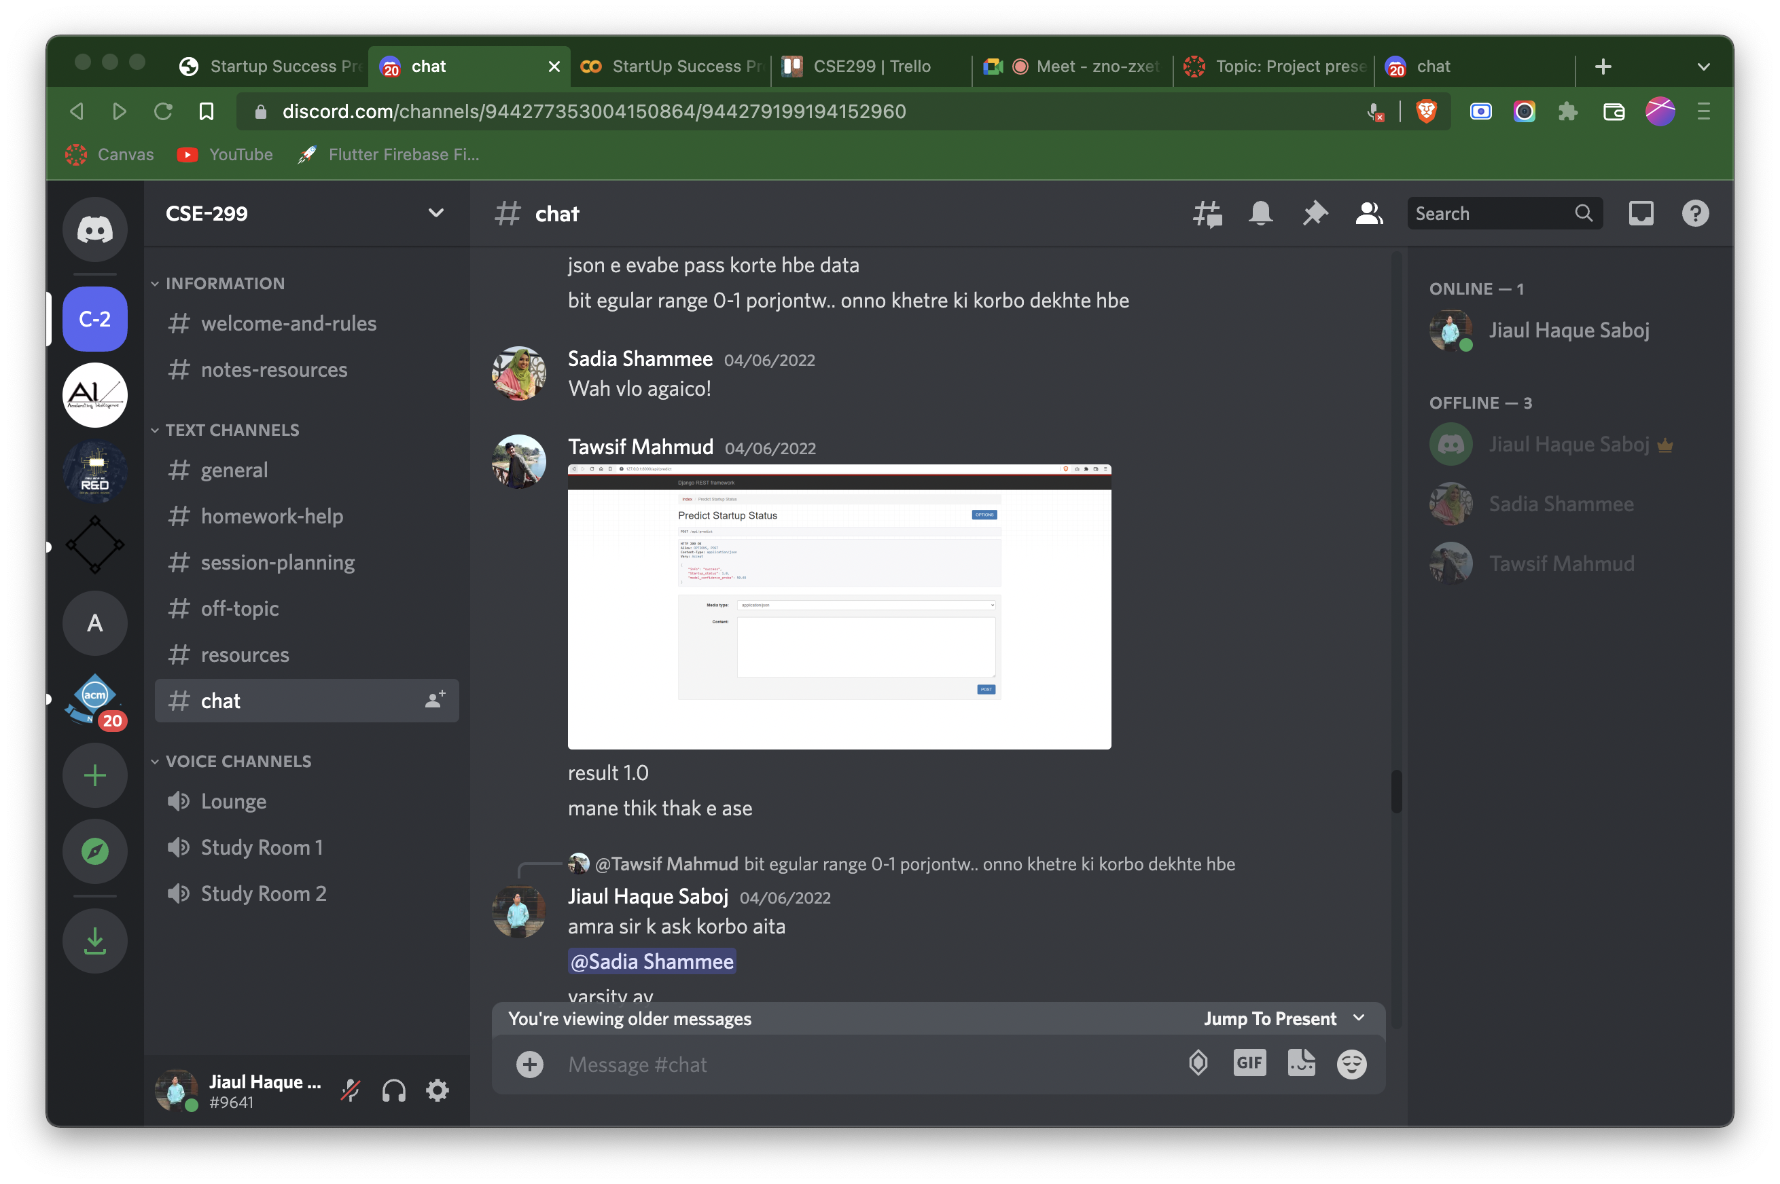
Discord’s Chat Screenshot

Slide 16
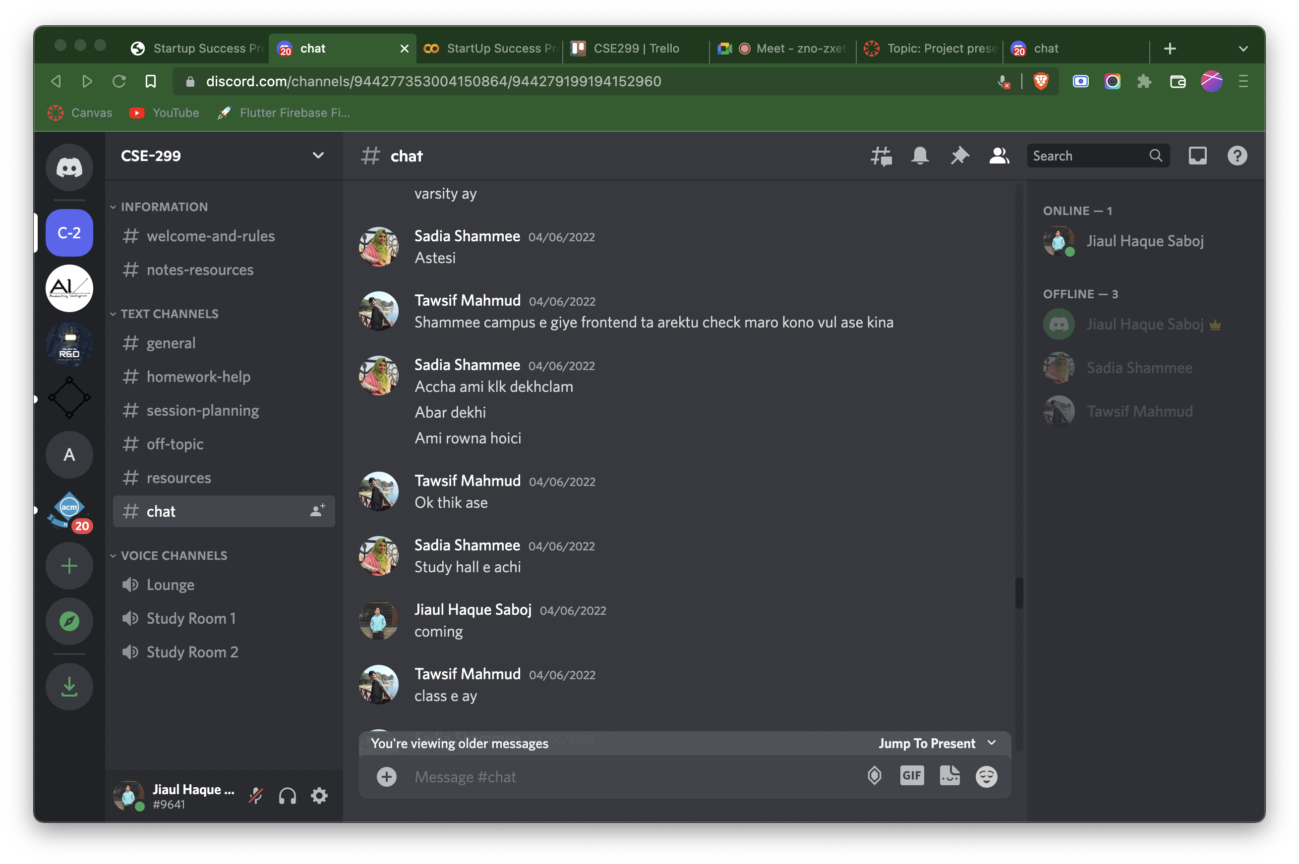

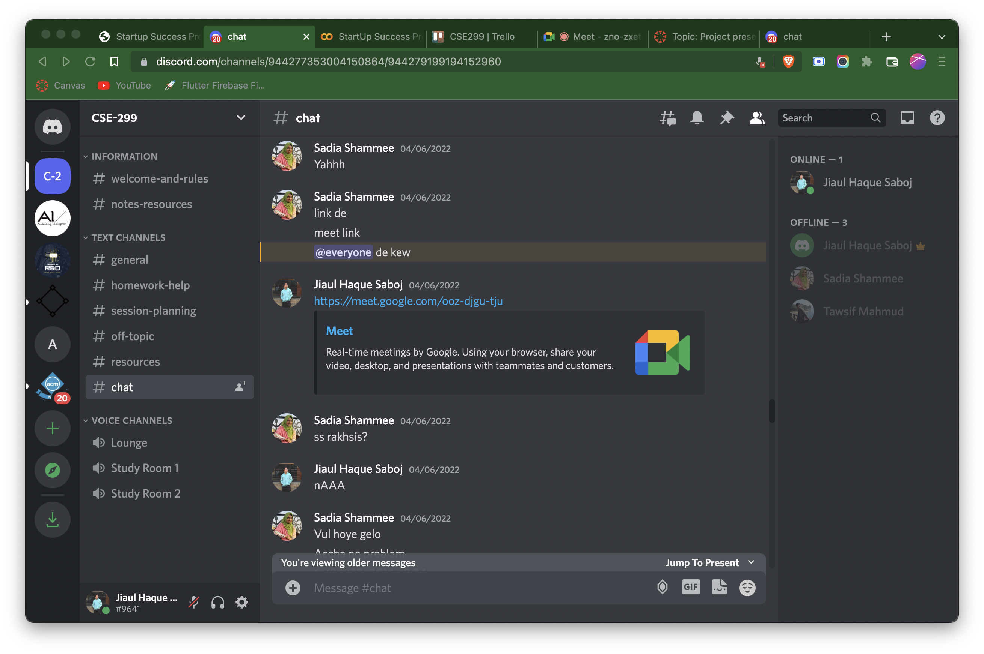
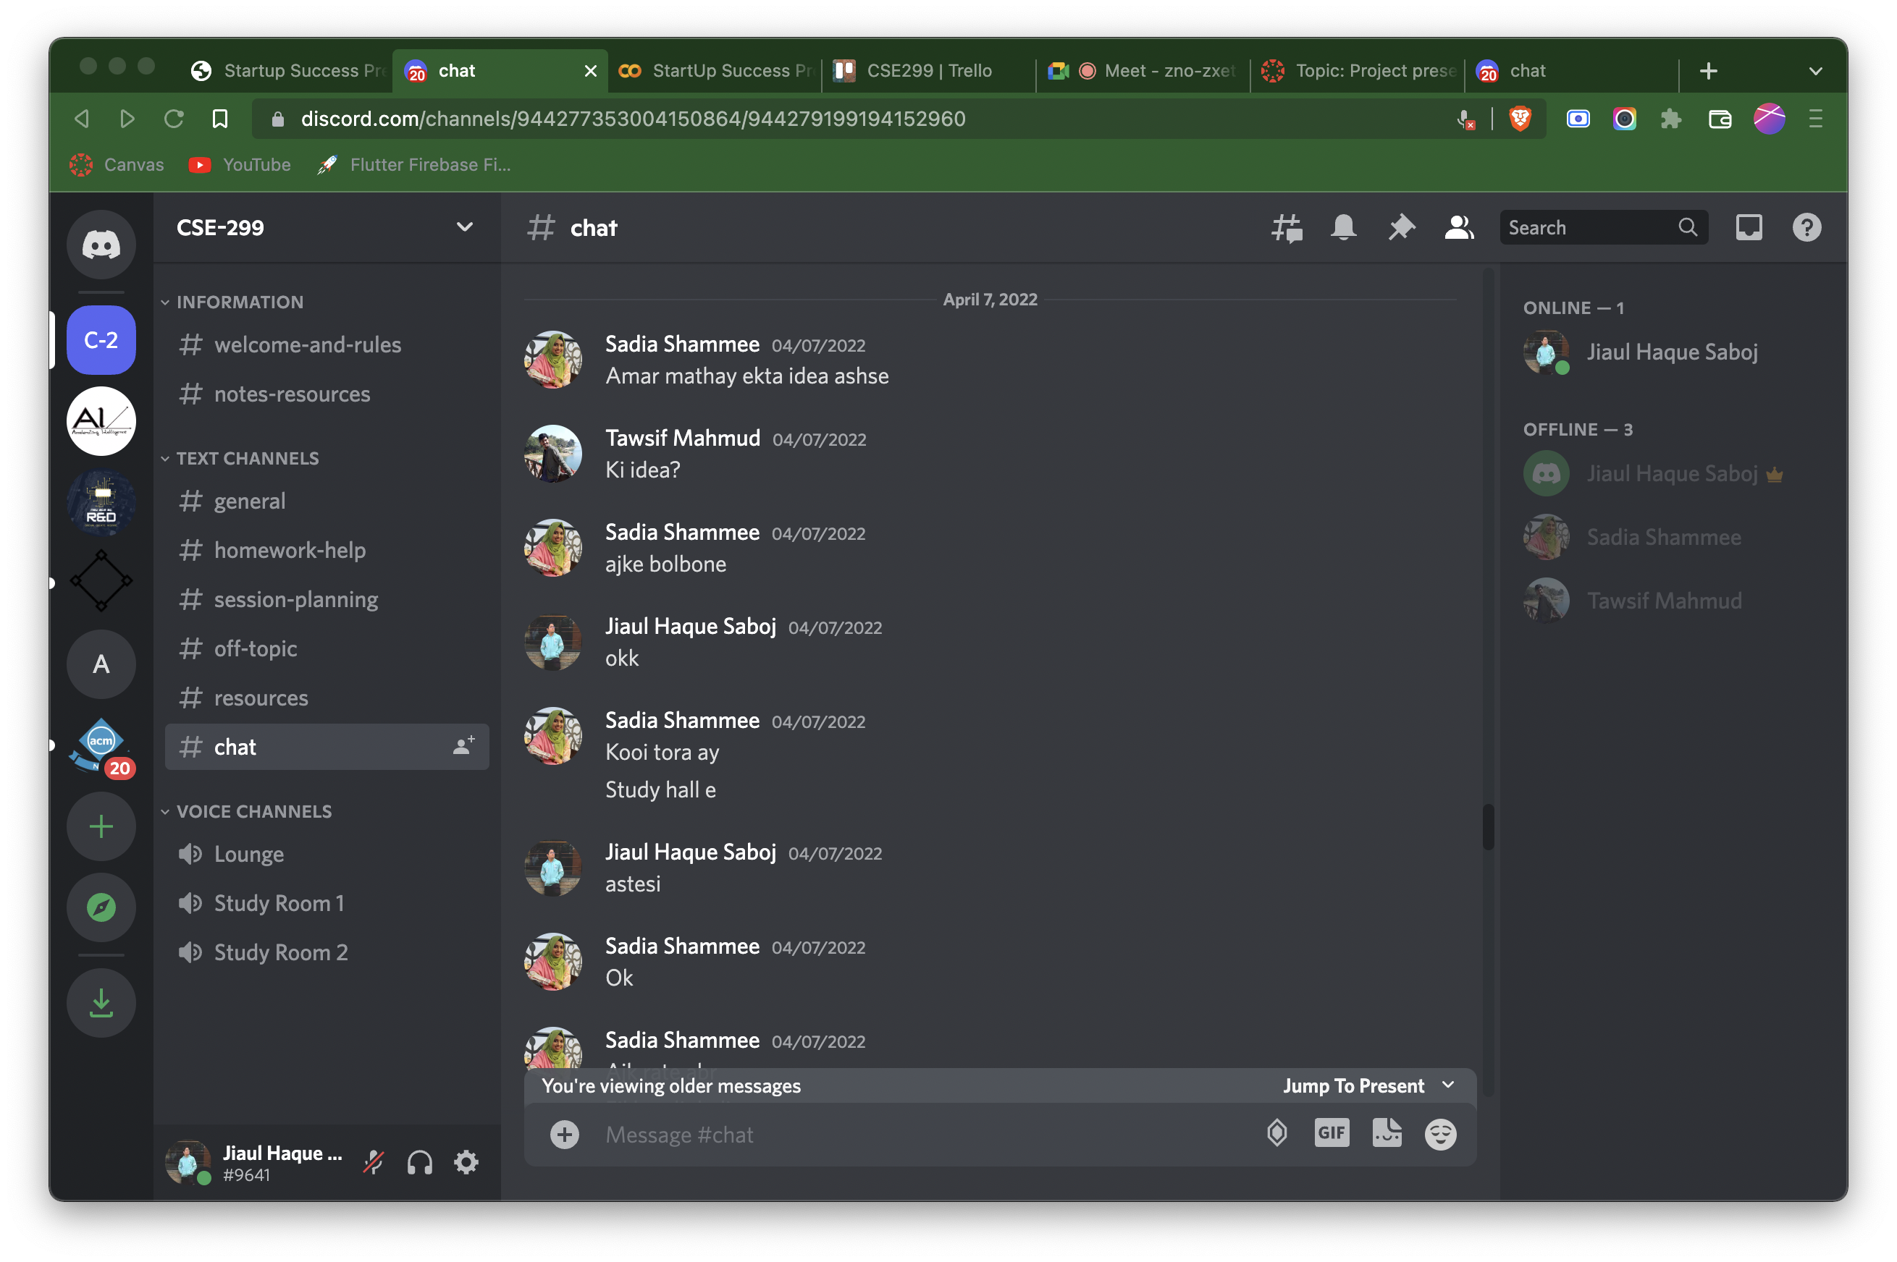
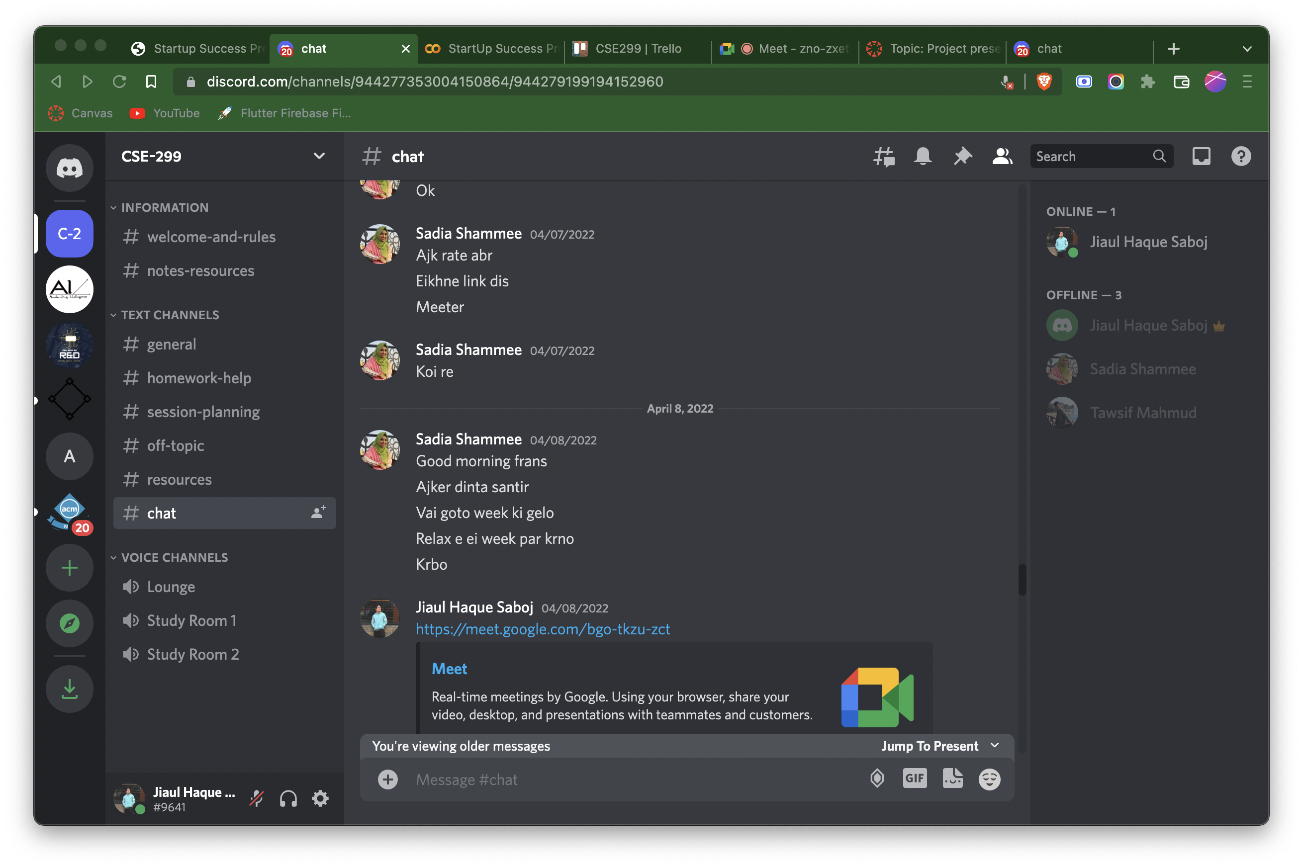
Discord’s Chat Screenshot

Slide 17
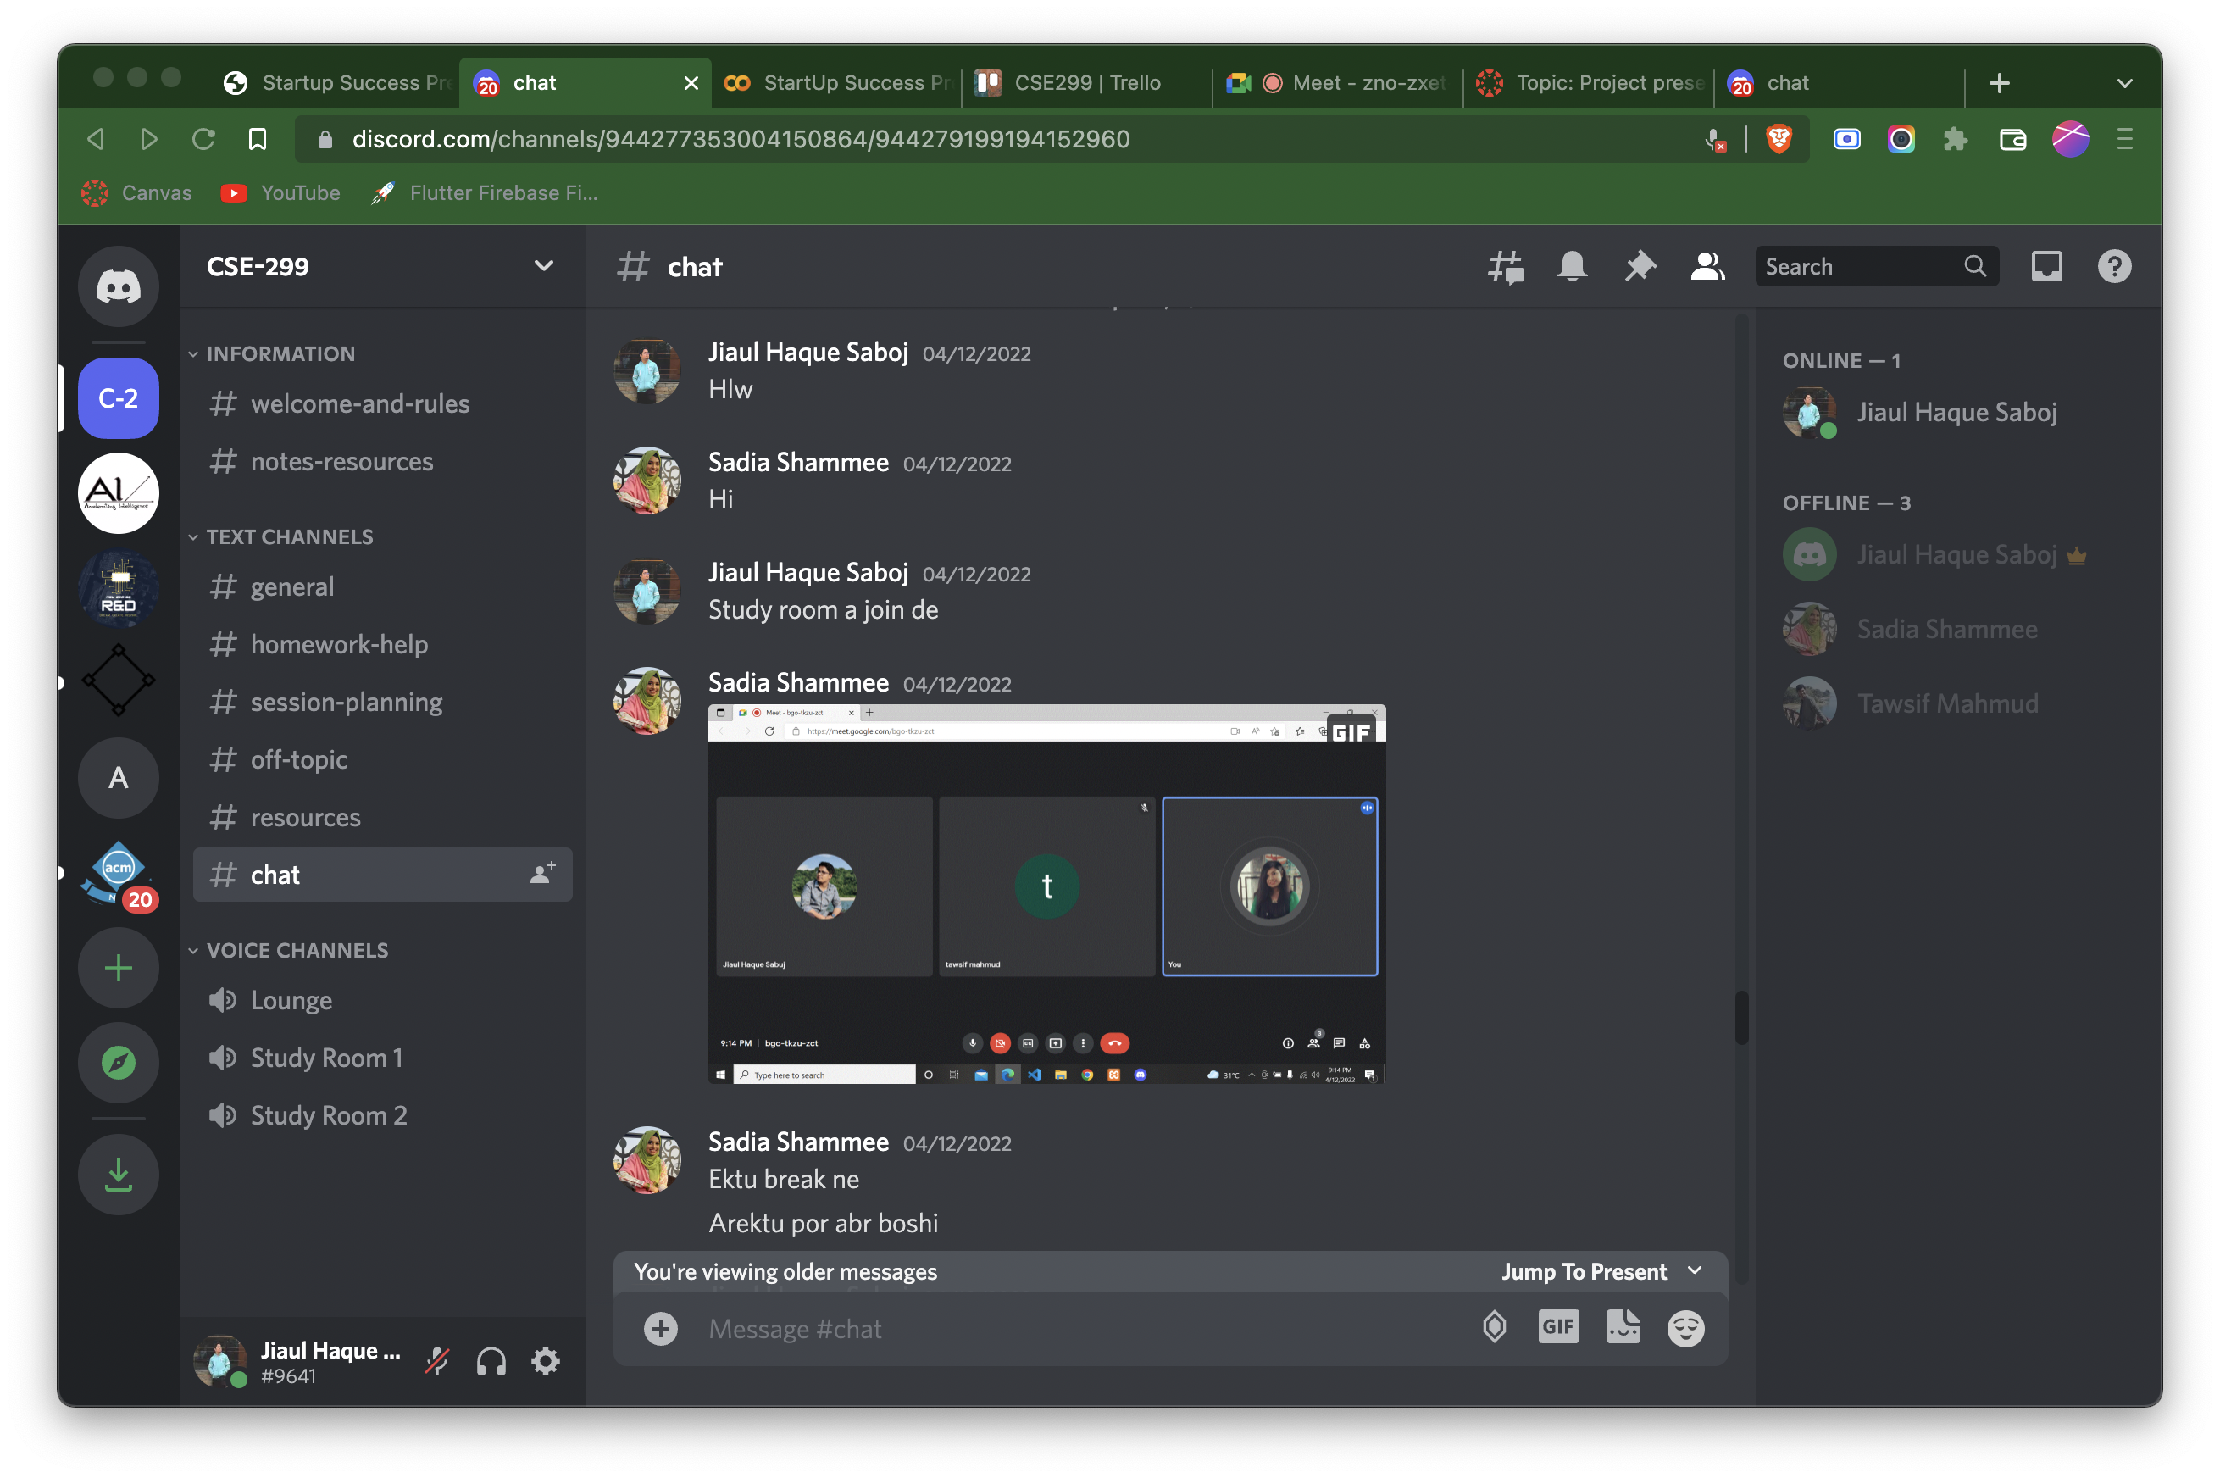
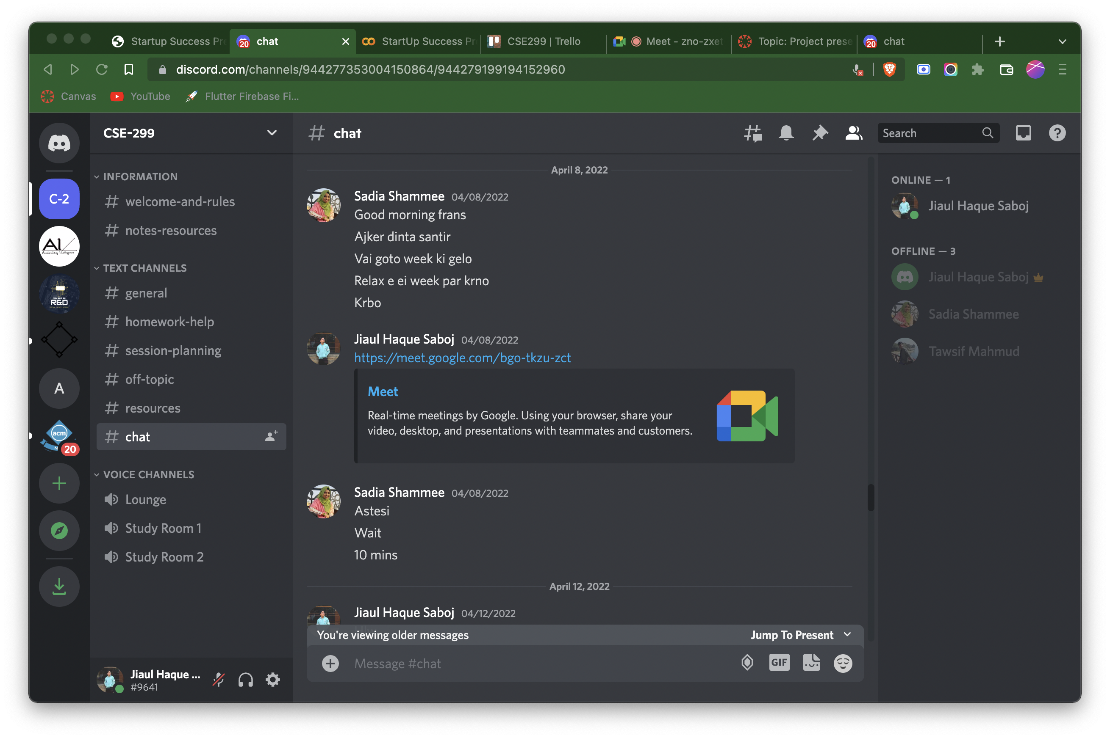
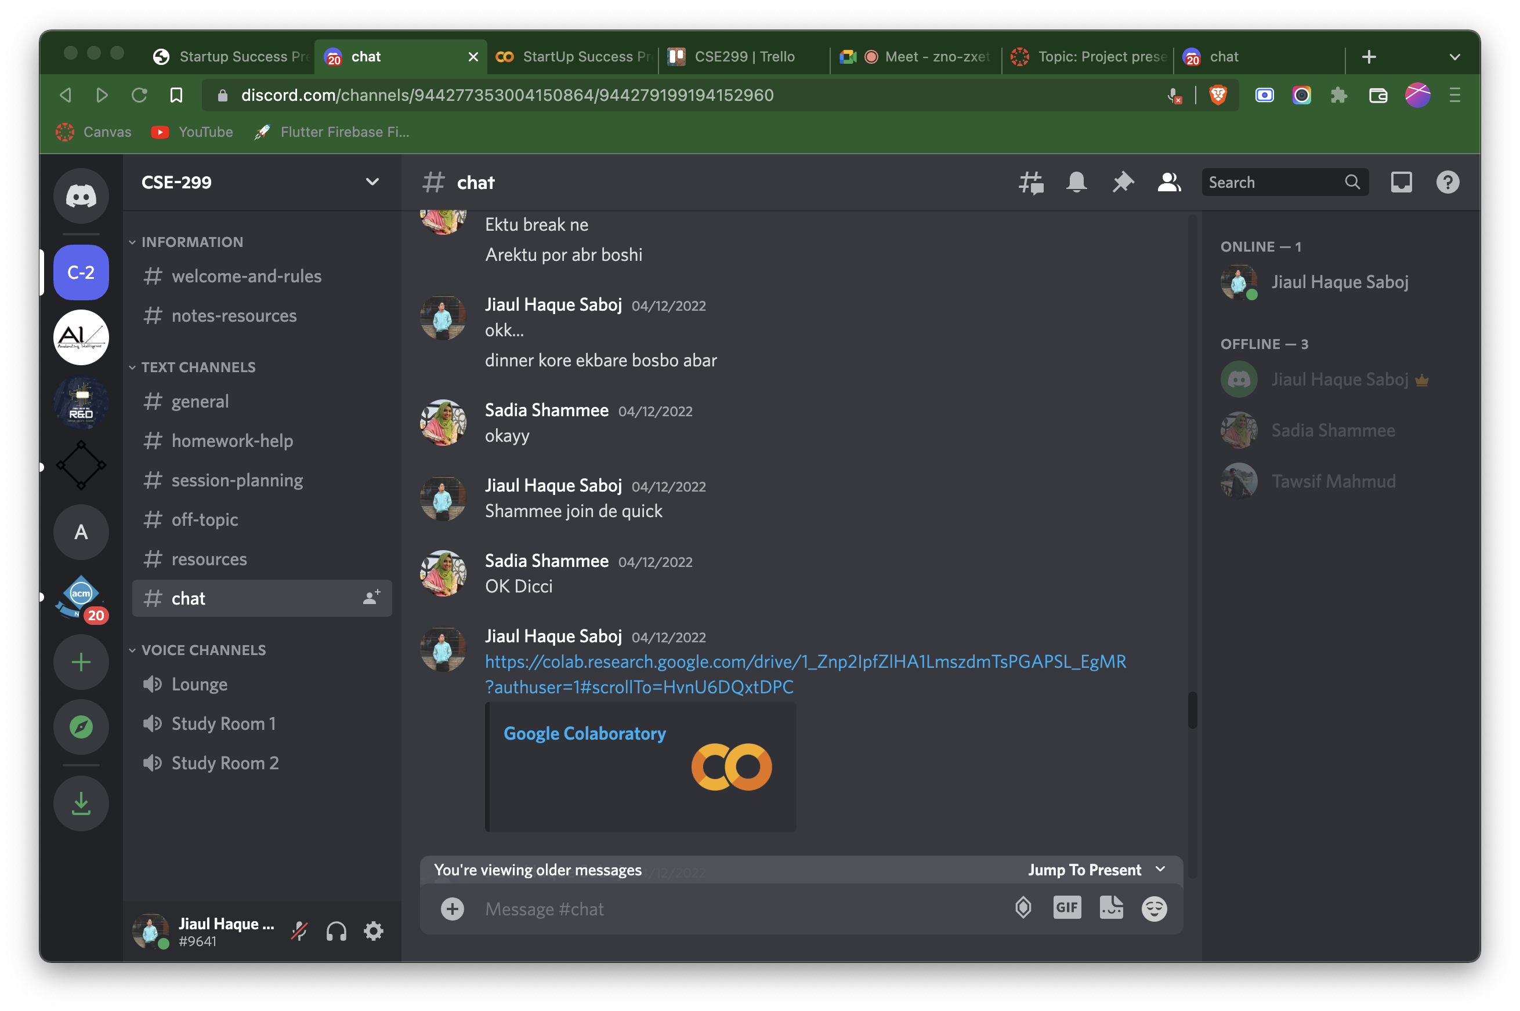
Discord’s Chat Screenshot

Slide 18
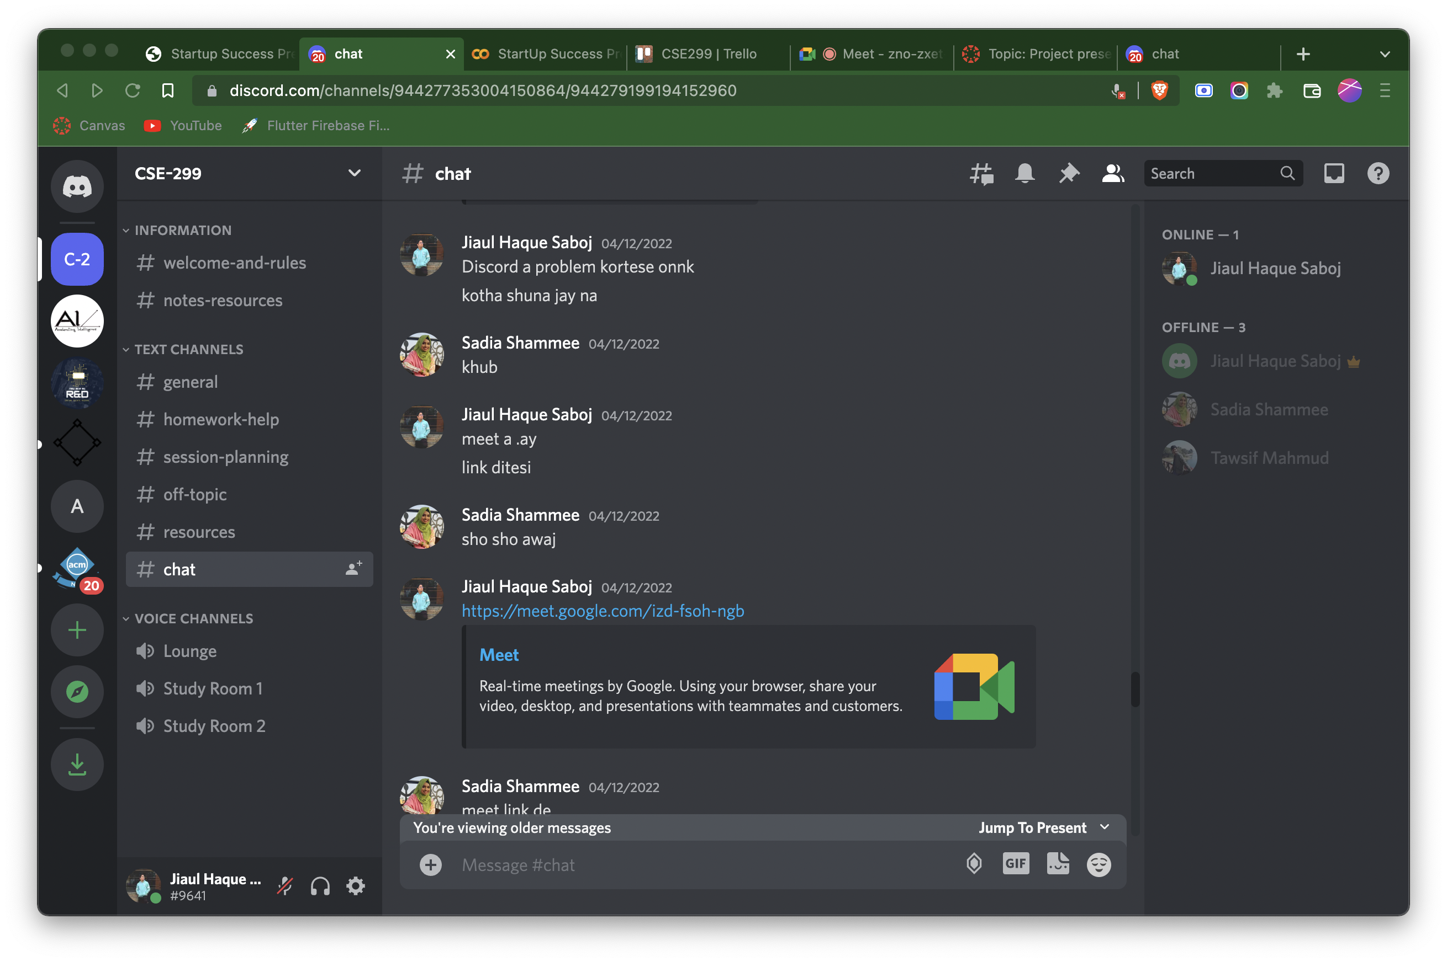
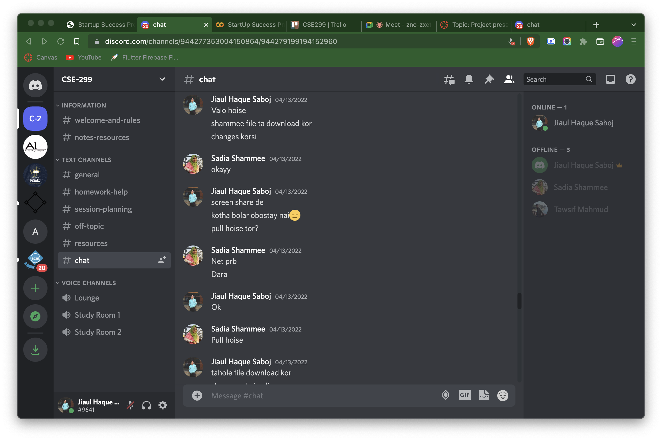
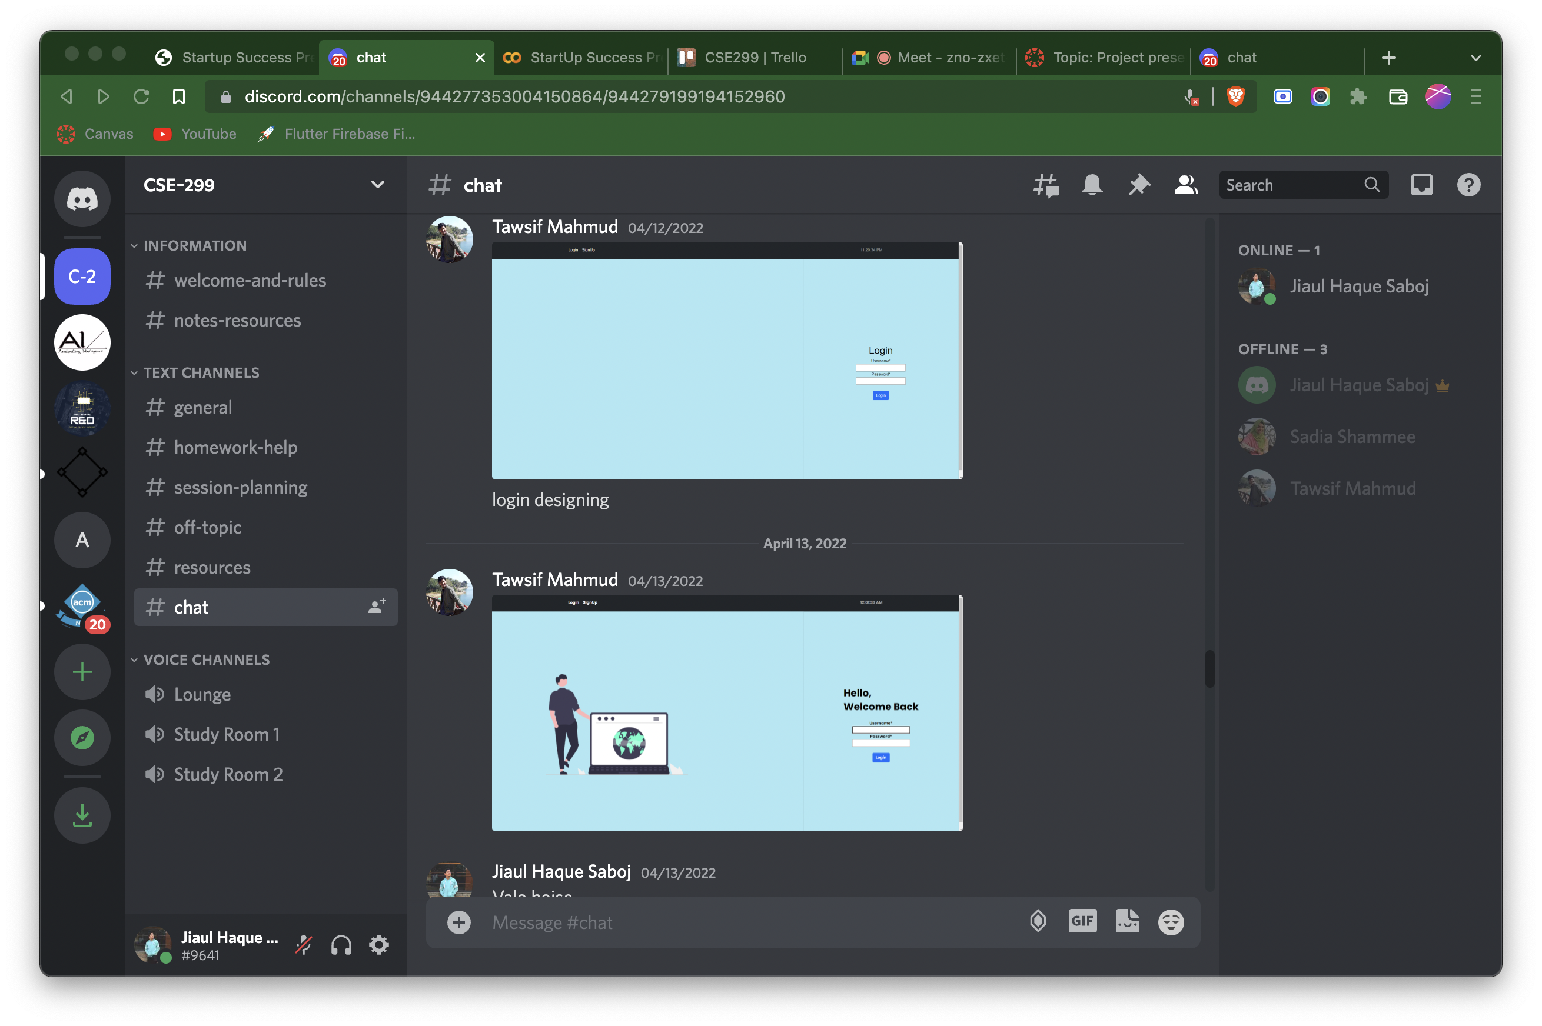
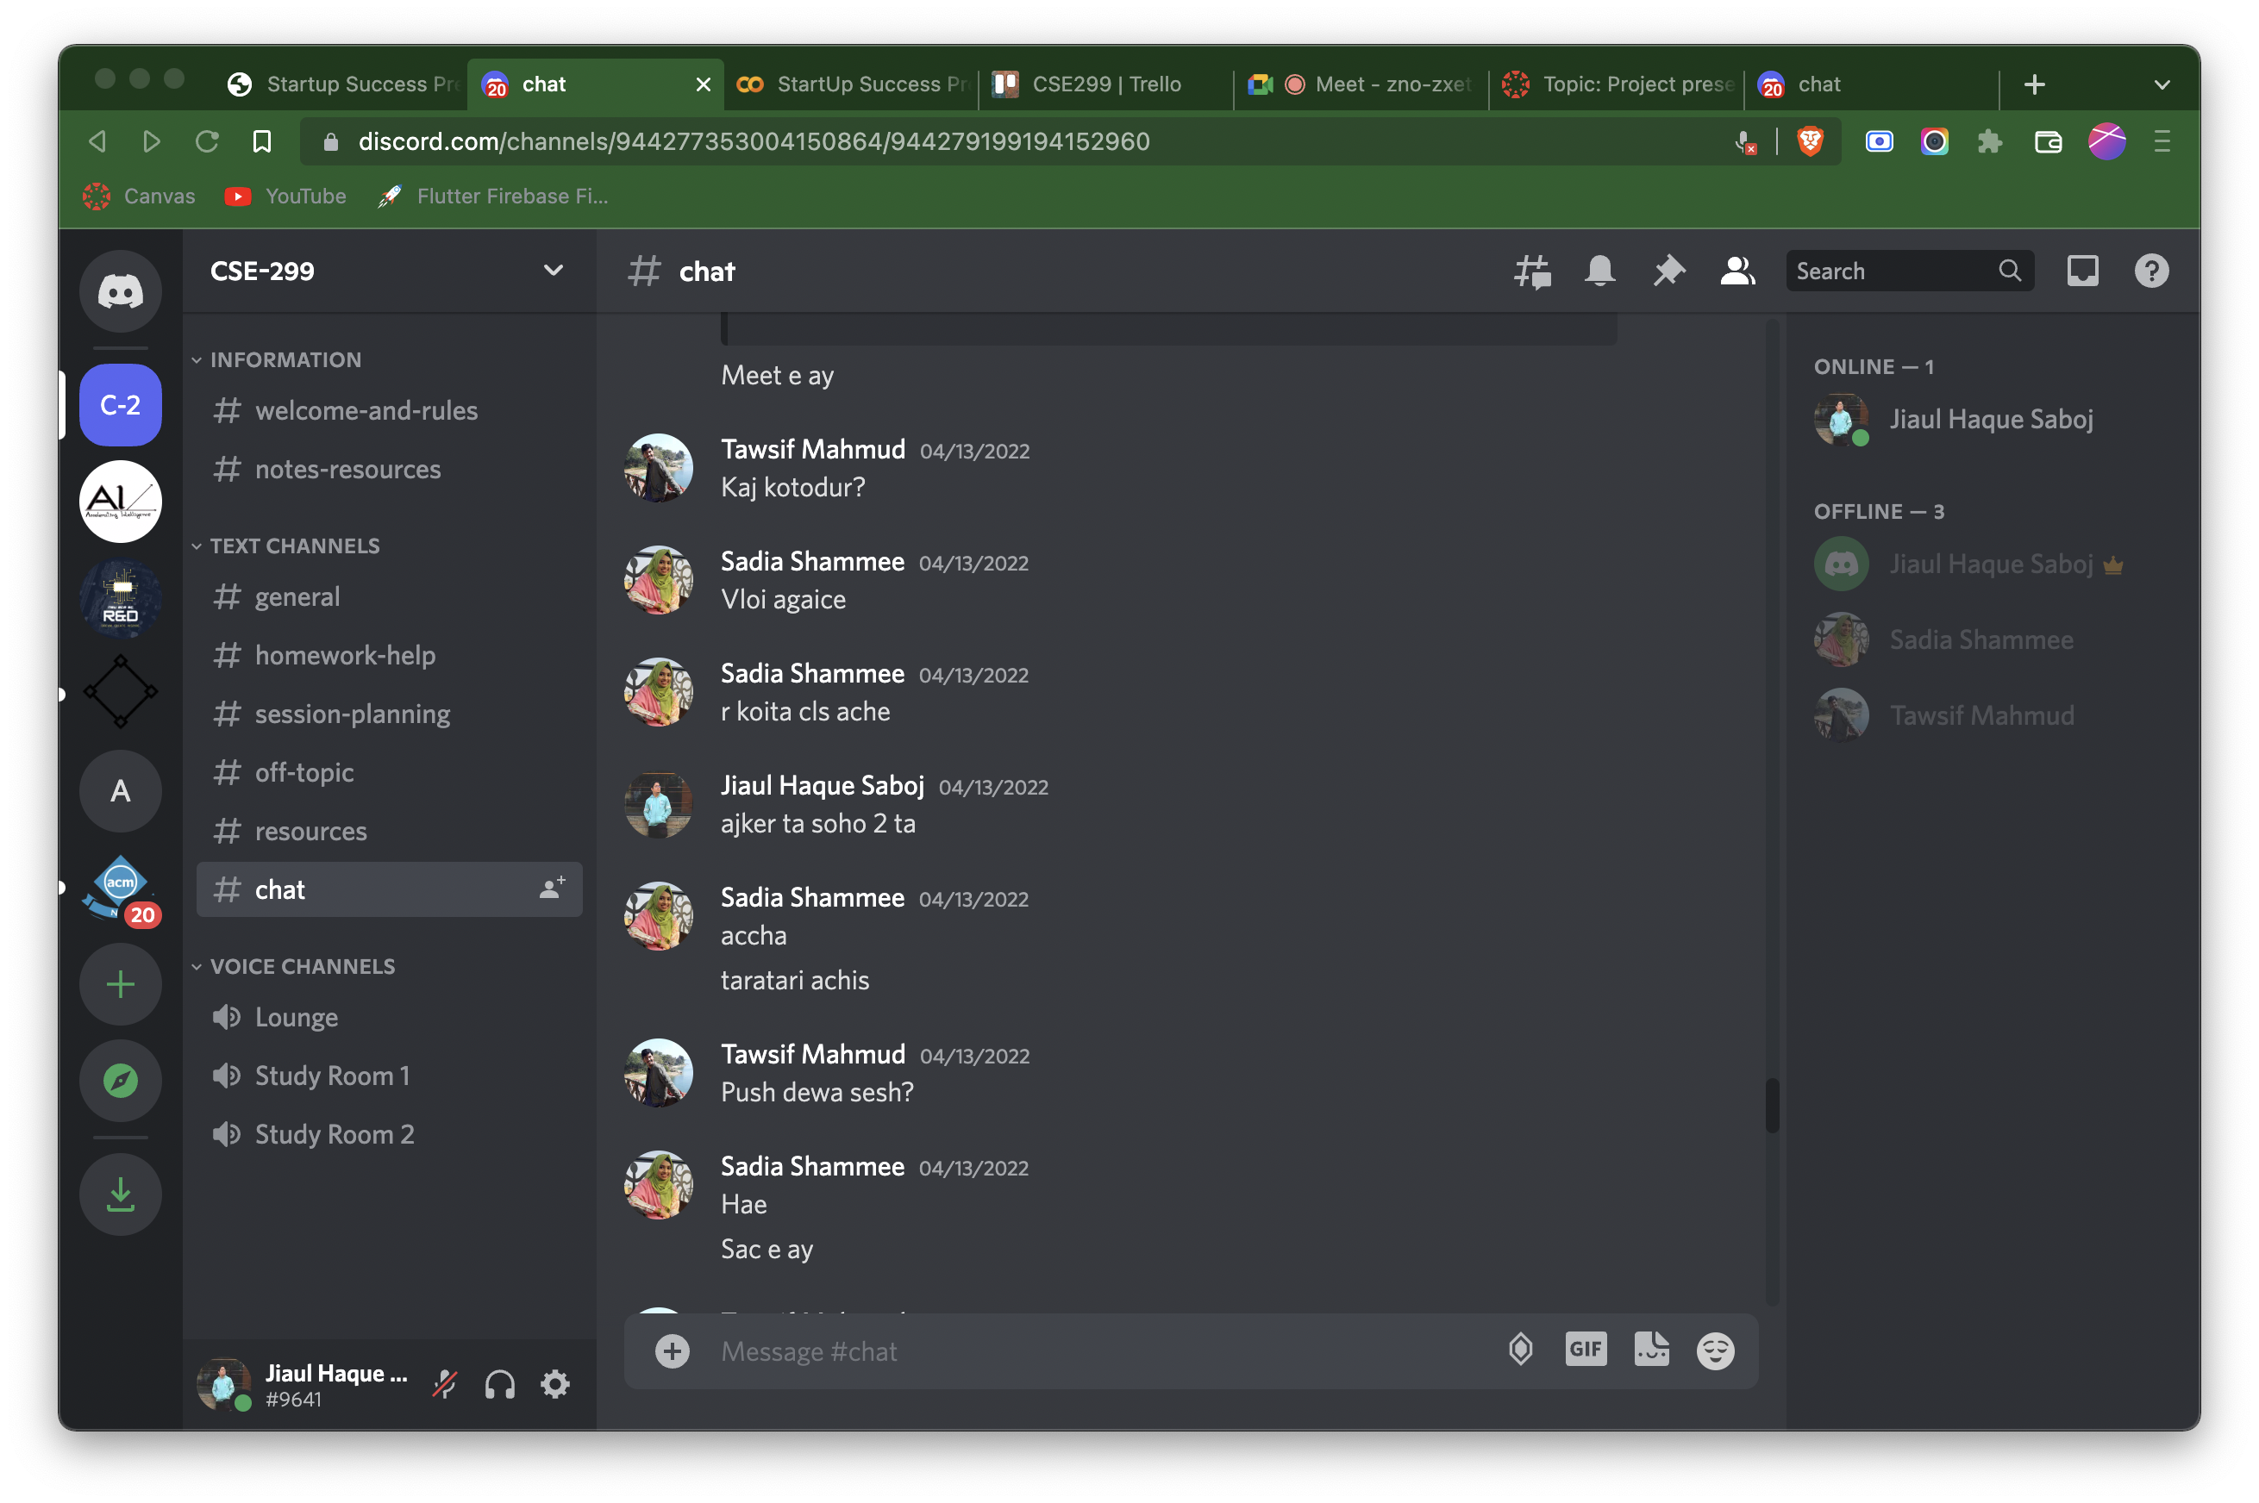
Discord’s Chat Screenshot

Slide 19
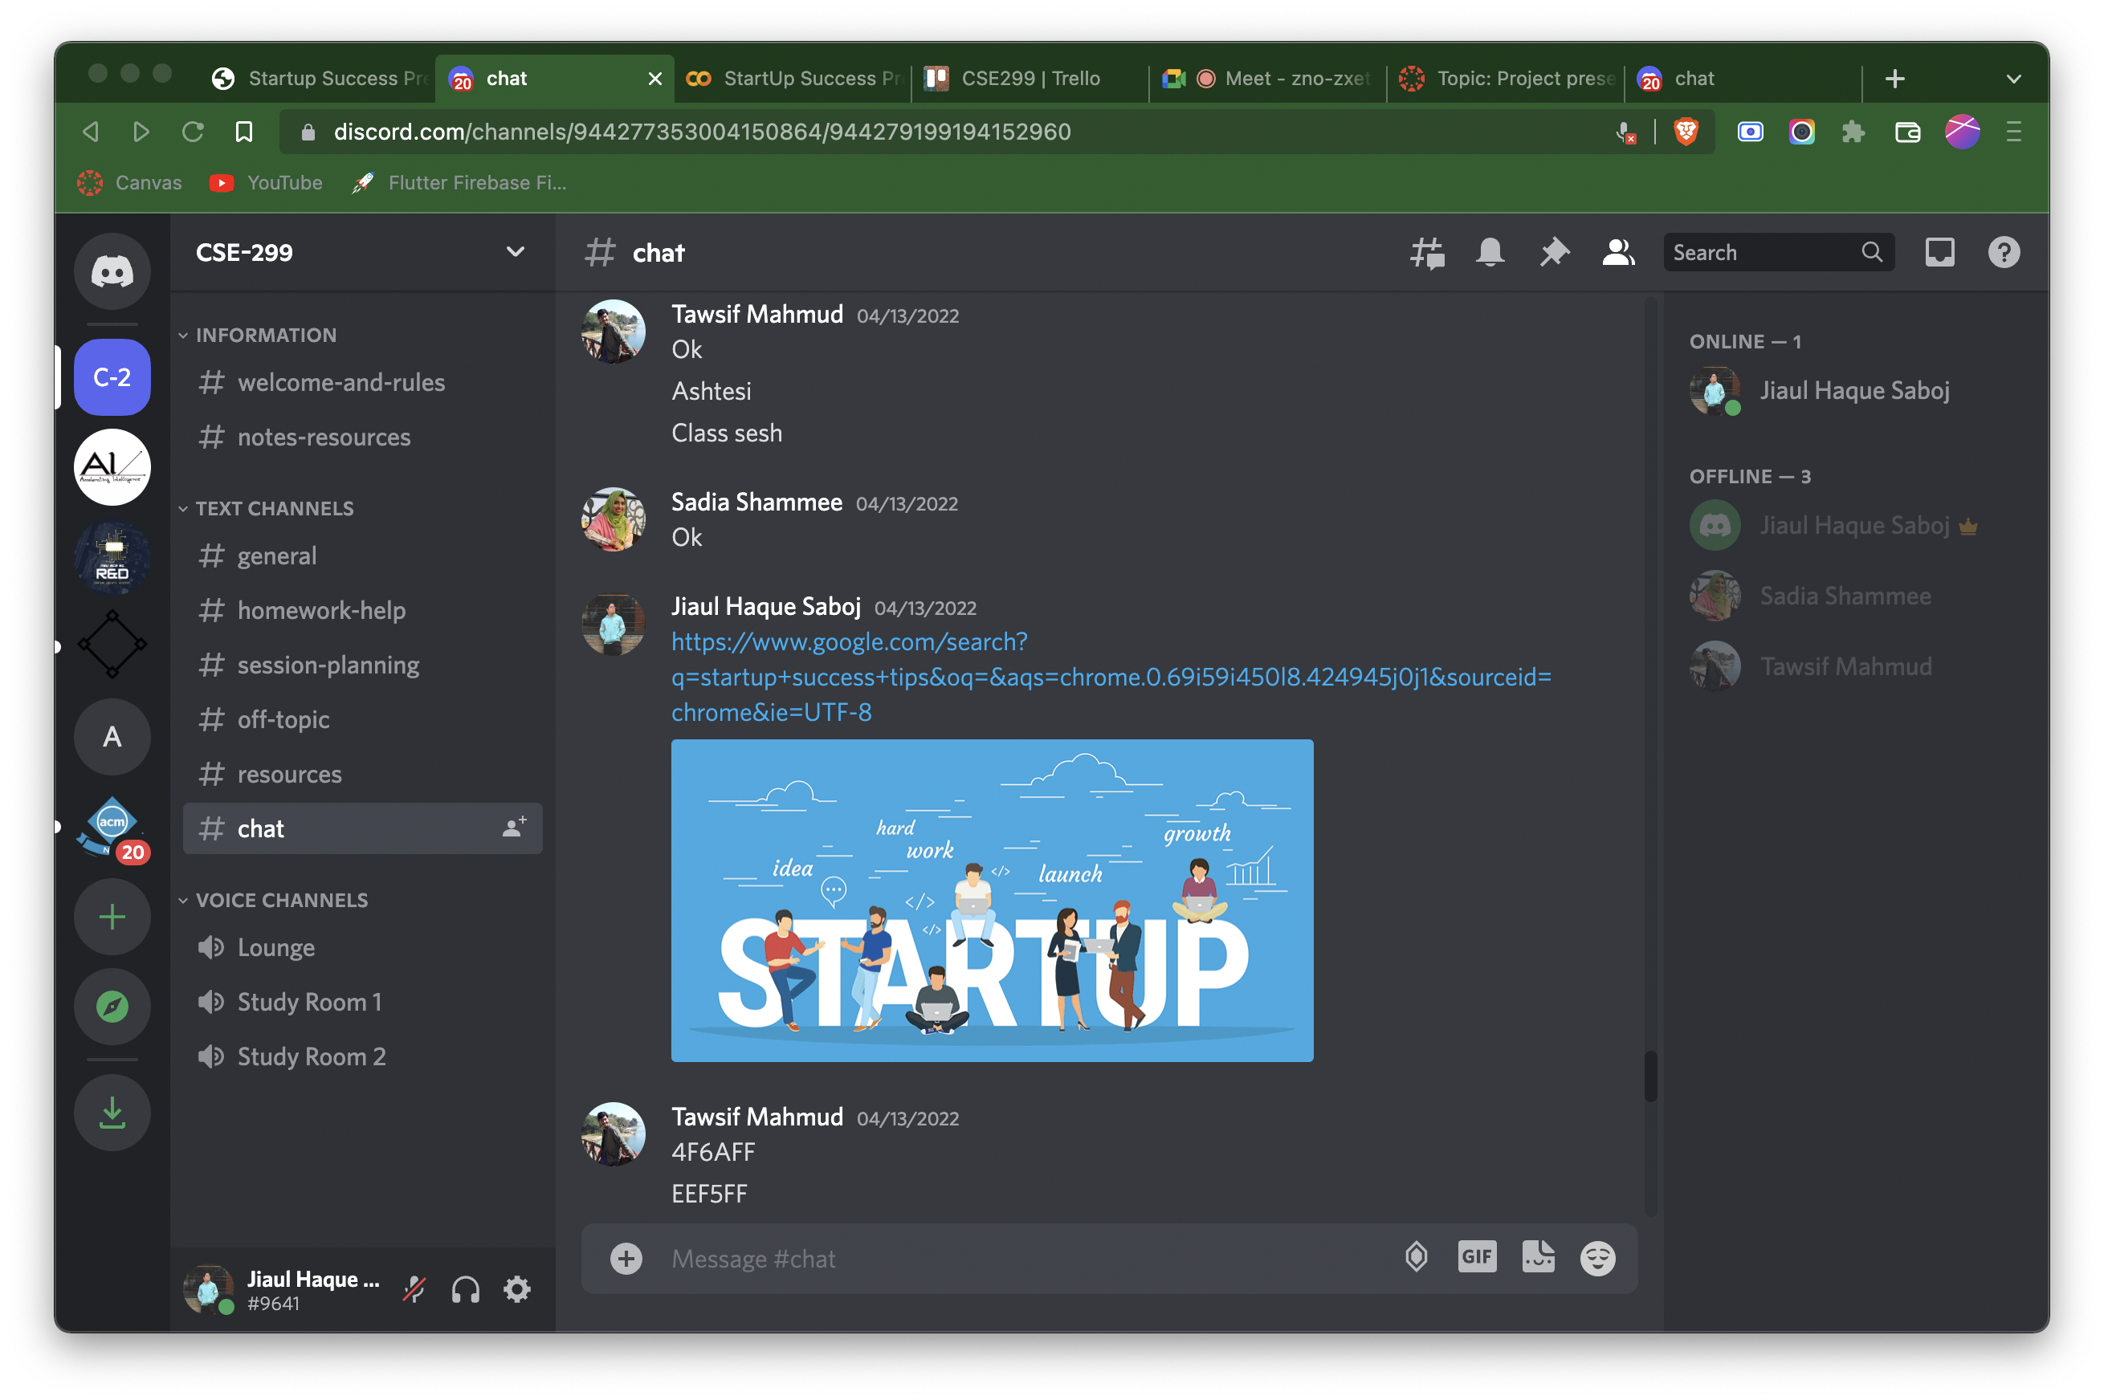
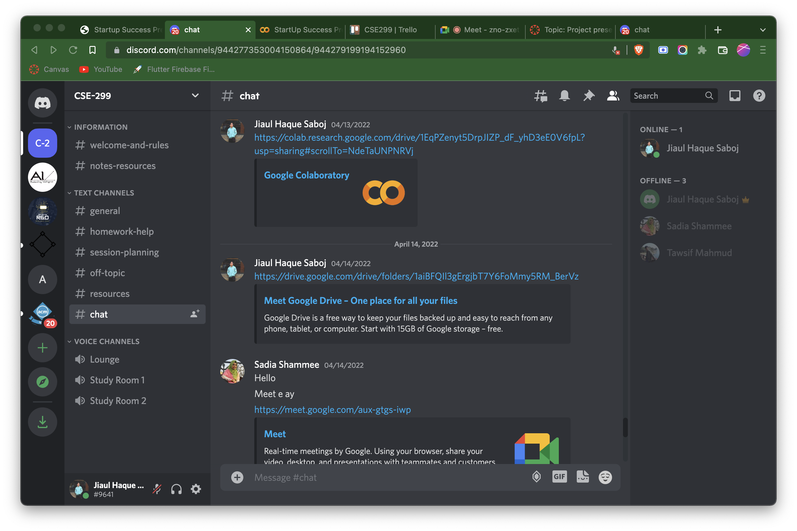

Discord’s Chat Screenshot

Slide 20
WEB PROJECT

Slide 21
MOBILE PROJECT

Slide 22
Thank YOU !!!

